Slide 1

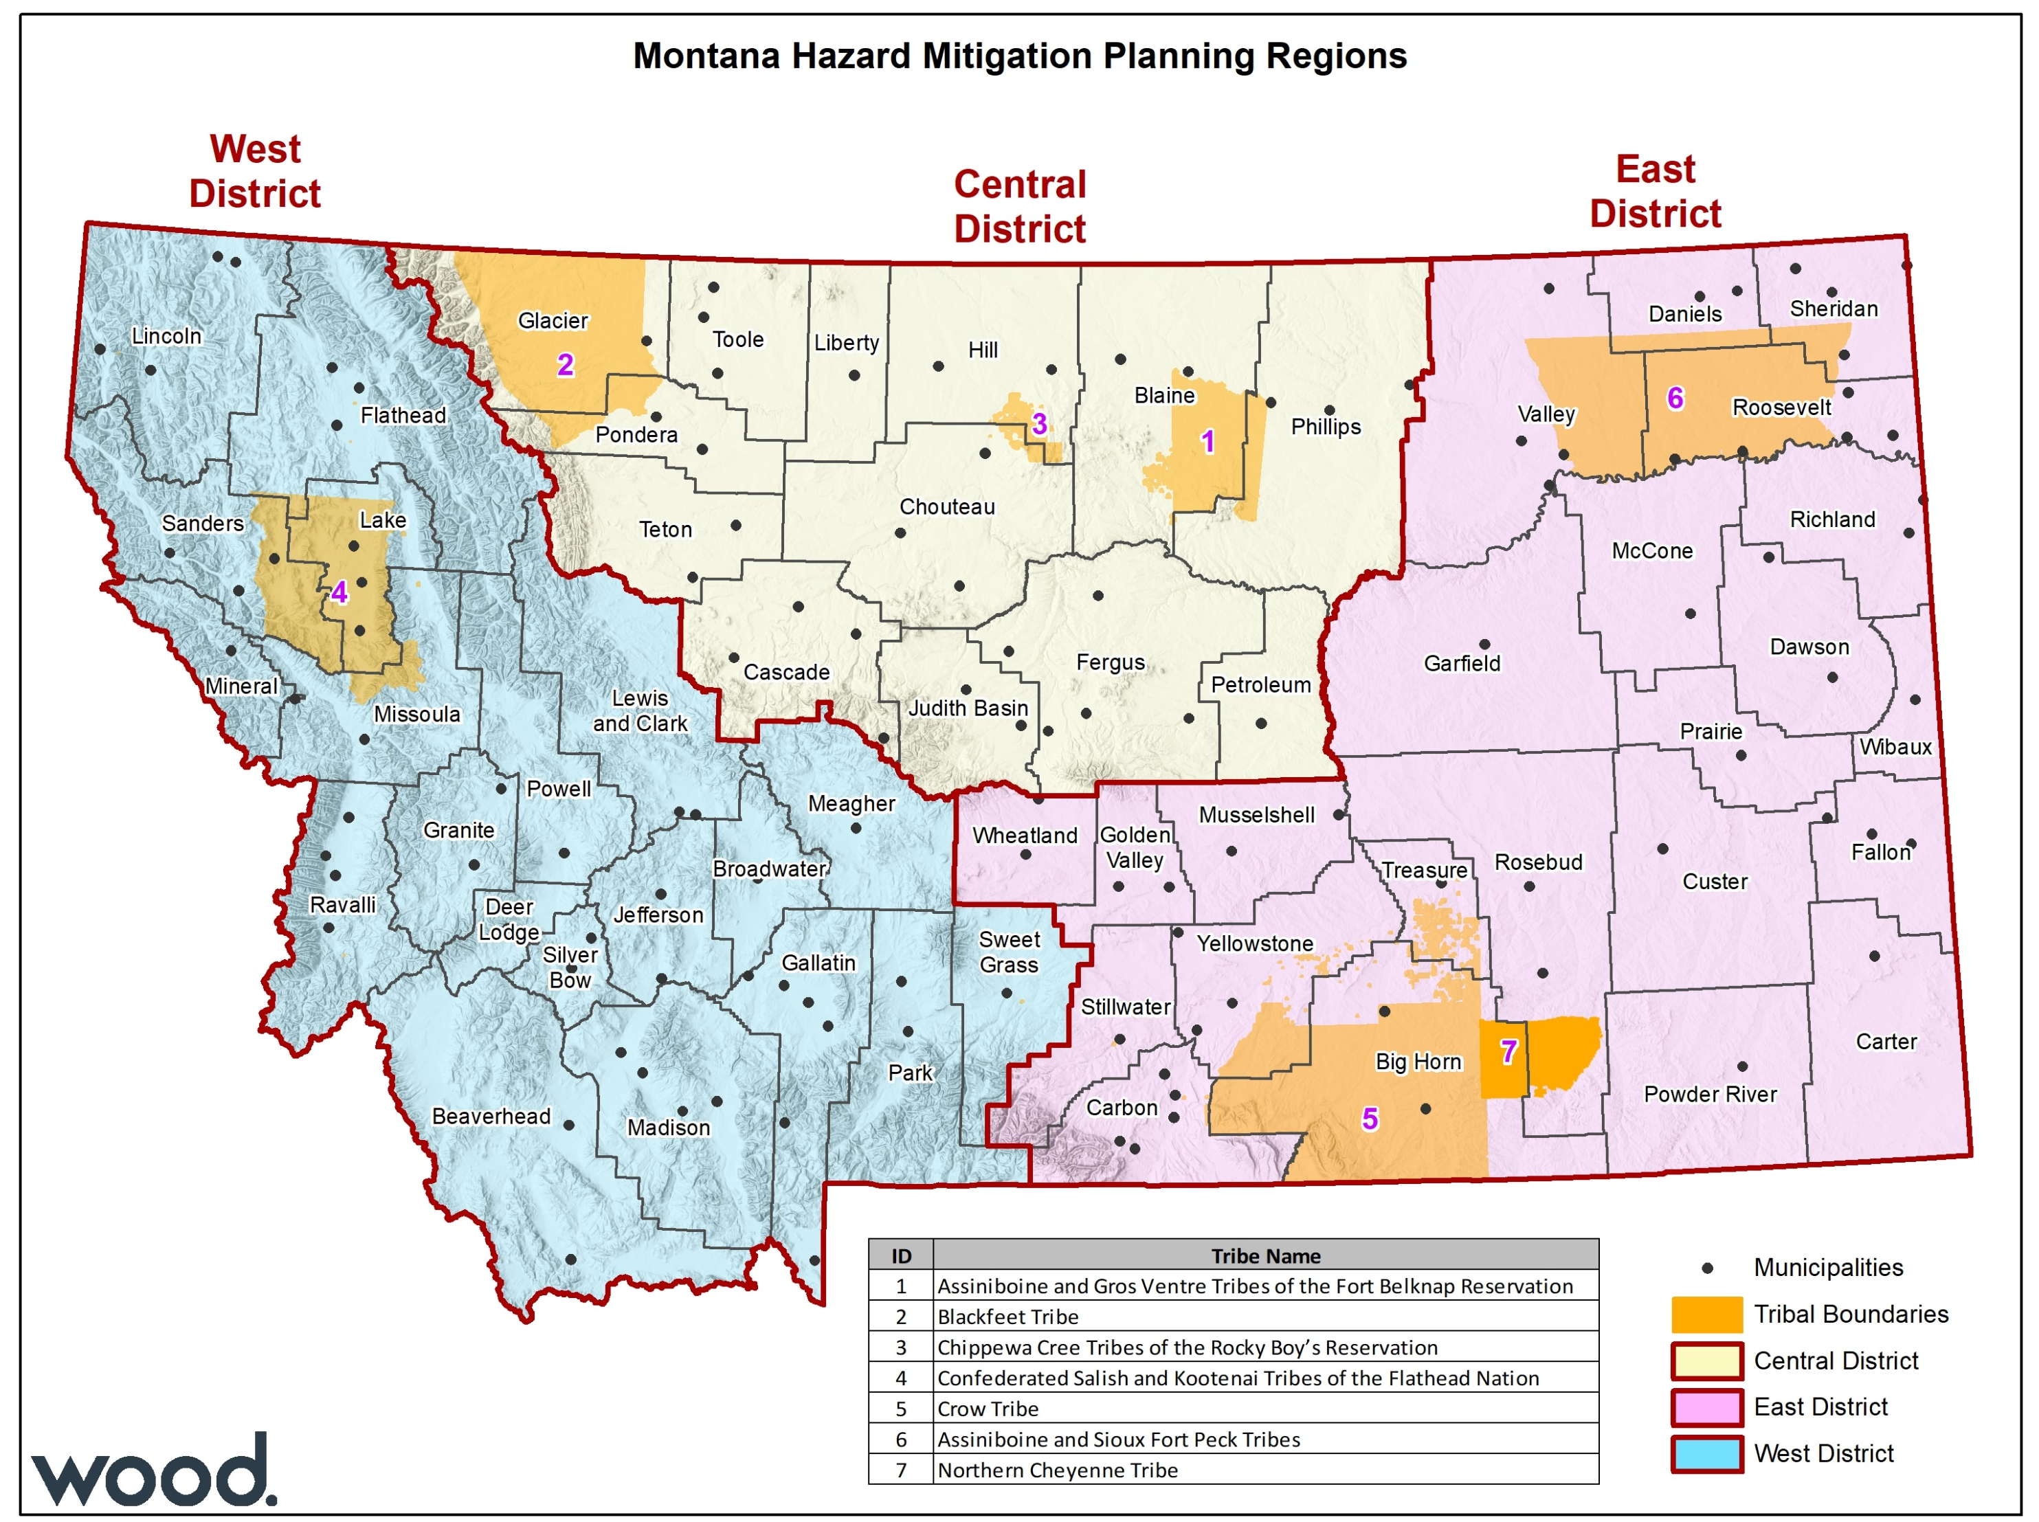

State of Montana Regional Hazard Mitigation Planning
Central Region Kick-Off Meeting
March 31, 2022: 10:00-11:30 MDT

Slide 2
Meeting Agenda
Introductions
Hazard Mitigation and Resilience Planning
Regional Planning Process Overview
Regional, County, & Tribal Hazard Mitigation Planning Committees
Review of Identified Hazards
Coordination with Related Planning Efforts & Recent Studies
Planning for Public and Stakeholder Involvement
Information Needs And Next Steps
Questions and Answers/Adjourn

Slide 3
Meeting Logistics
Please mute your mic when not speaking.
…but please feel free to unmute when you have something to say!
You can also use the chat log to make comments, ask questions, or provide information.
This meeting is being recorded.
Slides, meeting summary, and recording will be made available.
Meeting will use Slido polls to get feedback from participants.
Join at slido.com #CentralKickoff

Slide 4
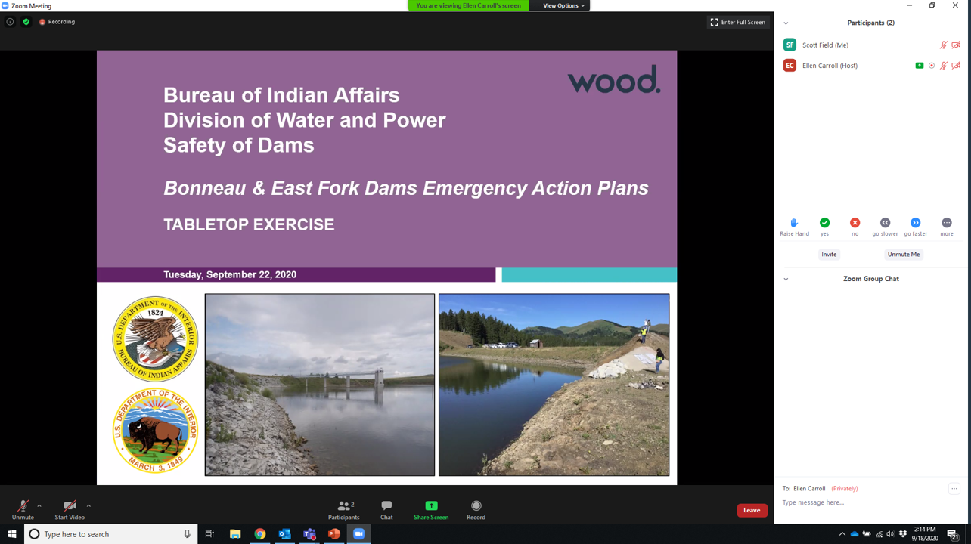
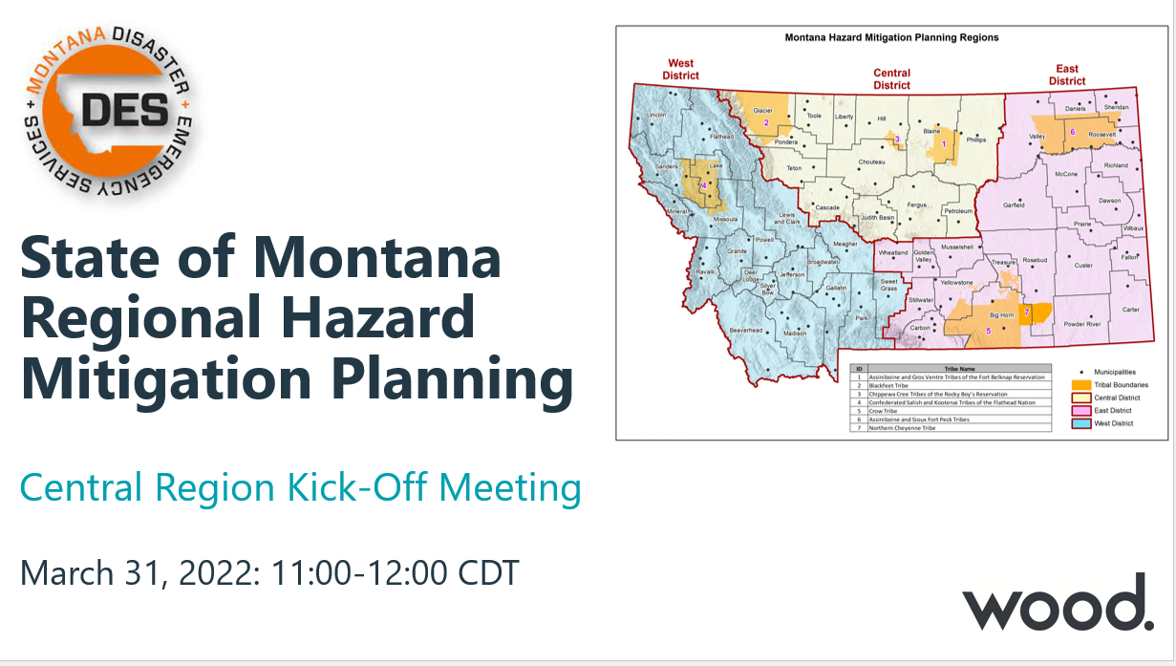
Zoom Overview
Call In Number: 646-558-8656
Meeting ID: 869 3509 4701, Passcode: 653918
If joining by phone - use *6 to mute/ unmute

Slide 5
Introductions

Slide 6
Introductions
Montana Disaster and Emergency Services
Sara Hartley – State Hazard Mitigation Officer
Hanna Shultz – Mitigation Coordinator
J. Lee Okeson – Central Region Supervisor
Joey Zahara – Central Region Field Officer
Ed Greiberis – Central Region Field Officer
County/Tribal Emergency Management Coordinators
Federal & State Partners
Other Stakeholders
Wood Project Team
Jeff Brislawn – Project Manger
Scott Field – Lead Planner, Central Region
Bob Vince – Project Principal, Local Support
Juliana Prosperi – Lead Planner, East Region
Amy Carr – Lead Planner, West Region
Mack Chambers – Lead GIS Analyst
Cameron Nelson – Hazard Mitigation Specialist
Chris Johnson – Hazard Mitigation Planner/GIS
Natalie Schoen – Hazard Mitigation Planner
Emily Geery – SWCA Wildfire Risk Assessment Support
Victoria Amato – SWCA Wildfire Planning Specialist
Jurisdictional representatives & stakeholders
Type your name, title, and affiliation in chat box

Slide 7


Join us at slido.com #CentralKickoff

Slide 8

If you didn’t have to be in the meeting today, what would you rather be doing?
ⓘ Start presenting to display the poll results on this slide.

Slide 9

Have you participated in a hazard mitigation plan before?
ⓘ Start presenting to display the poll results on this slide.

Slide 10
Hazard Mitigation and Resilience Planning

Slide 11
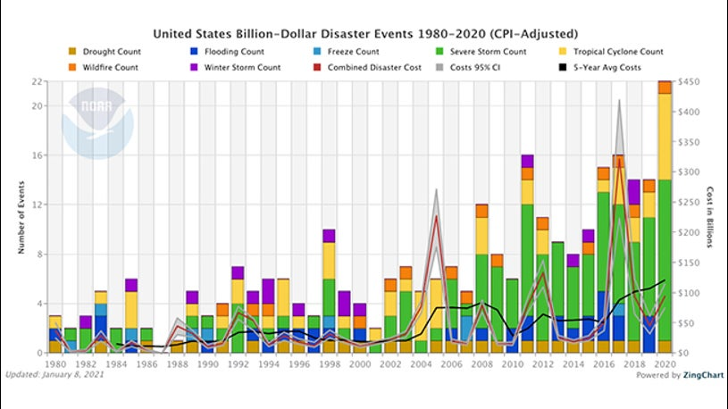
Trends Resulting in Increased Disaster Costs
Population & community growth
More people living in hazardous areas
Greater exposure to risk: people, infrastructure, buildings
More hazard events
More disaster declarations
Increase in disaster response & recovery costs

Slide 12
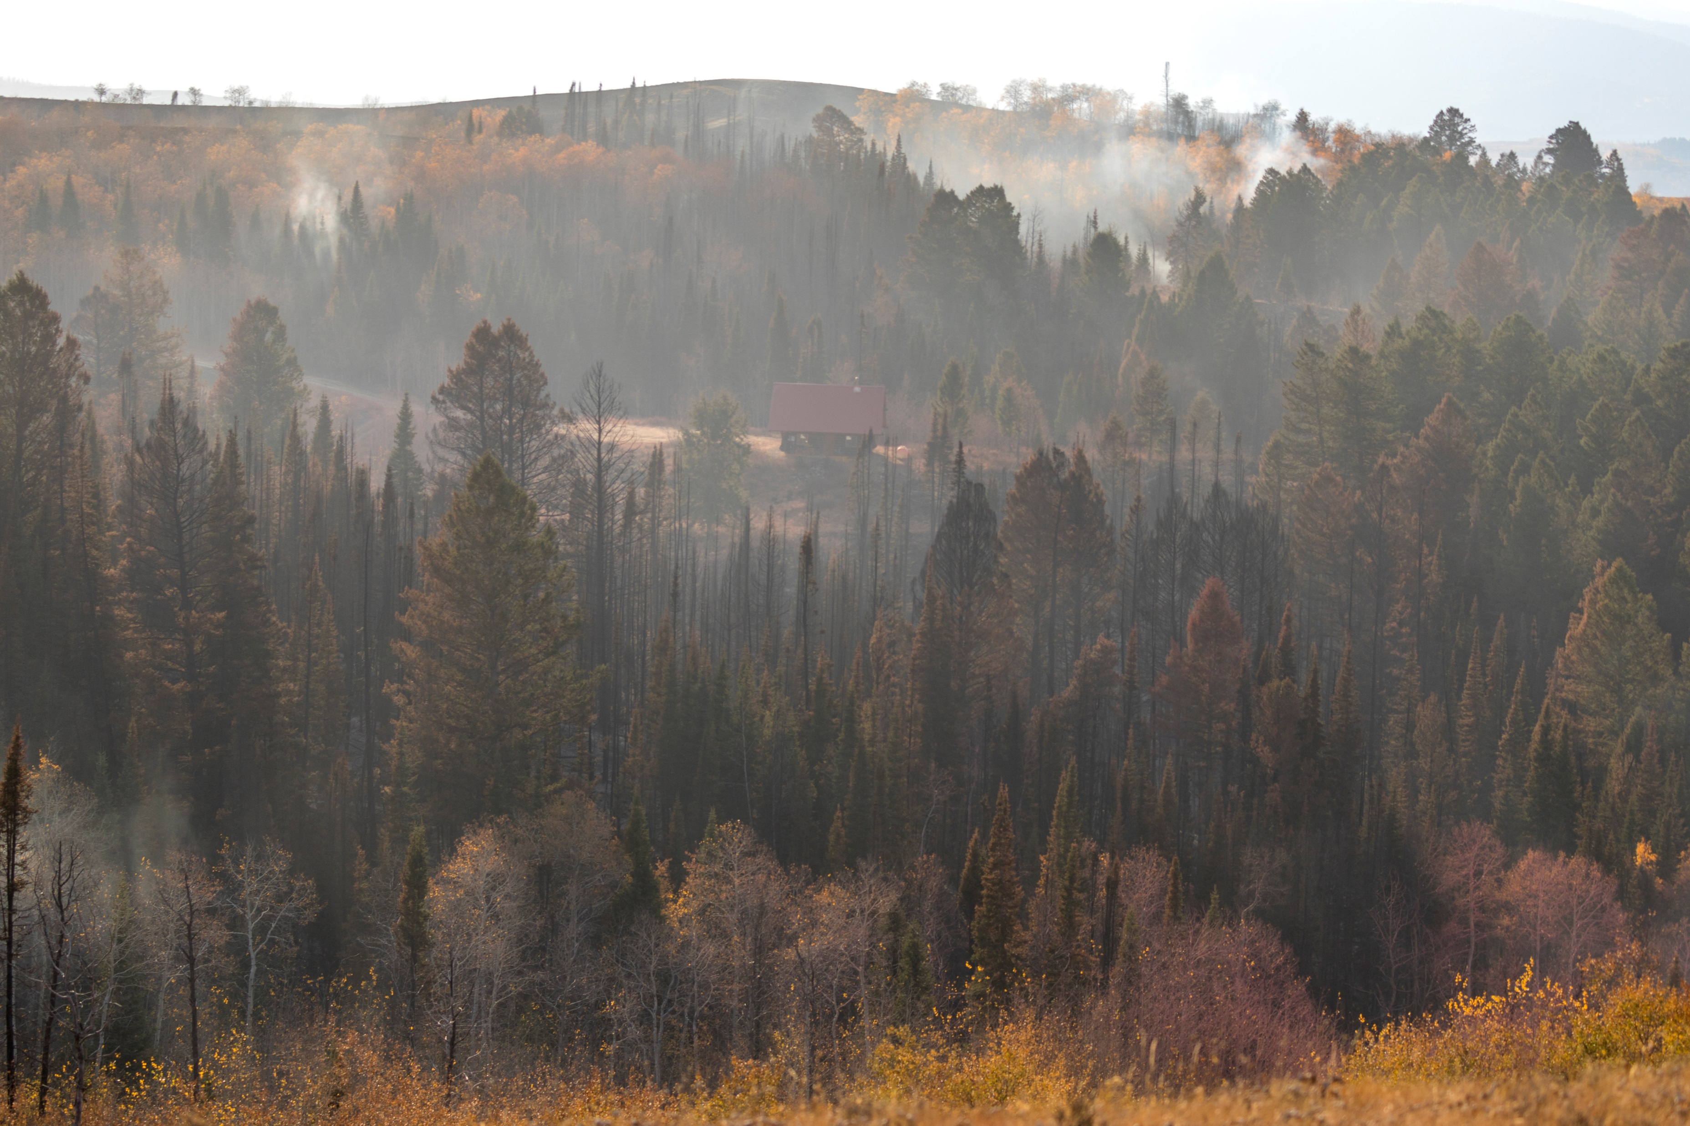
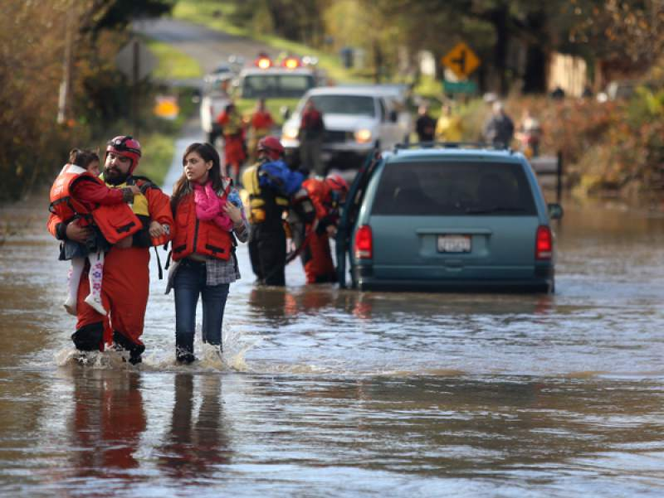
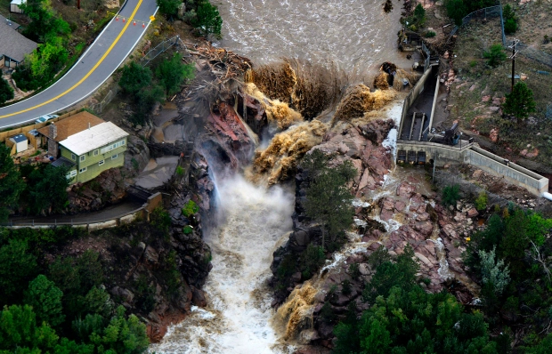
Why Addressing These Trends is a Priority
Legal and ethical responsibilities
The increasing costs of response and recovery
The cost of ‘doing nothing’ is too high
Many events are predictable and repetitive
Loss reduction activities can be undertaken
They work well
Cost effective and environmentally sound
Funds are available to help
Notes:
National Institute of Building Sciences, Natural Hazard Mitigation Saves: 2019 Report: 6:1 overall Benefit-Cost Ratio on federal mitigation grant projects

Slide 13
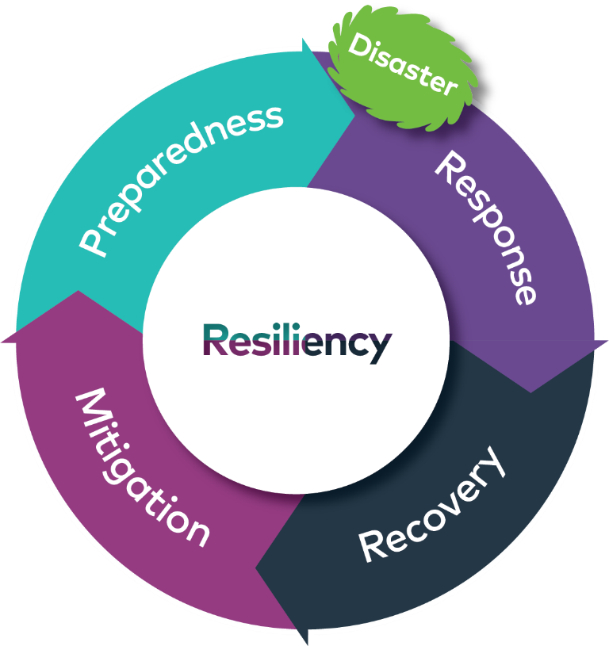
How Can We Reverse These Trends? Hazard Mitigation!
Mitigation: Any sustained action taken to reduce or eliminate long term risk to human life and property from hazards.

Slide 14
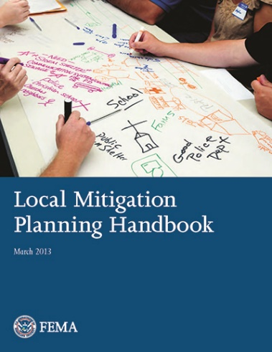
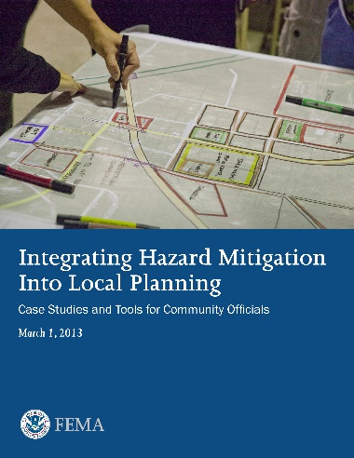
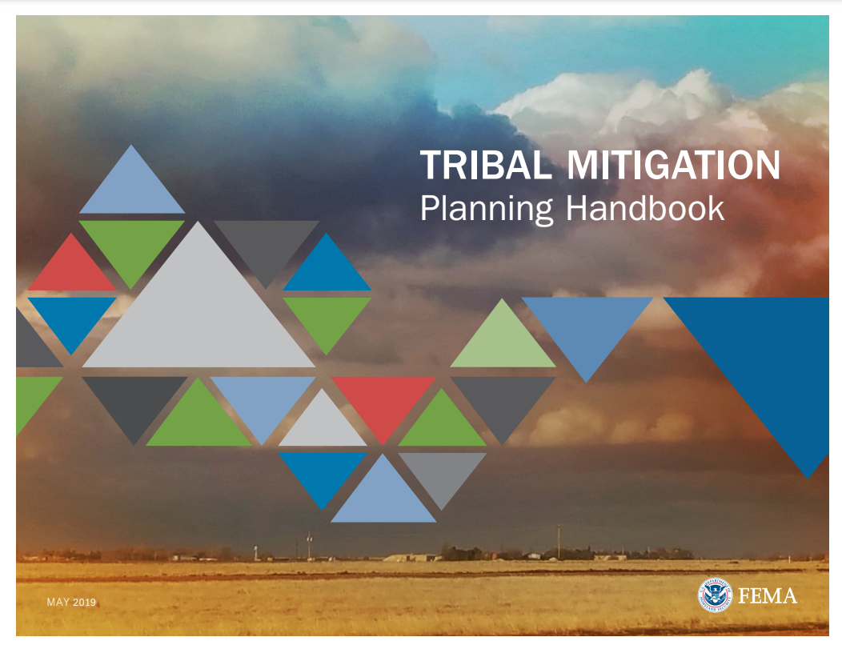
Disaster Mitigation Act of 2000
Federal Legislation
44 CFR 201.6
Requires communities to update their hazard mitigation plans every 5 years to remain eligible for federal pre- and post-disaster funding for hazard mitigation grants from FEMA
Plan ensures the jurisdictions in the Region will remain eligible for mitigation projects when funding becomes available
Tribal Mitigation Planning Guidance updated in 2017 and 2019

Slide 15
DMA Planning: What it is and Why it’s Important
Identify risks and solutions in a pre-disaster environment
Creates eligibility for mitigation funds, pre and post disaster
Guide mitigation activities in coordinated and economic manner
Incorporate into other existing planning mechanisms
Consider impacts to future development: Plan and build wisely
Reduce losses
Make community more disaster resilient

Slide 16
What the Plan is Not
Not a regulatory document – It does not create new regulations.
Not a commitment of resources:
FEMA and the State encourage communities to be both ambitious and practical.
Both FEMA and the State understand that actions are dependent on the availability of resources.
Communities will not be punished for not completing actions in the plan.

Slide 17
Regional Hazard Mitigation Plan Development 2022
Overview of Key Elements
Convene Hazard Mitigation Planning Teams
Create an updated plan per latest FEMA/DMA requirements and EPA Regional Resilience guidelines
Update the risk assessment to reflect current hazards, risk and vulnerability
Obtain progress on mitigation actions from prior plans
Develop new mitigation actions
Document progress and note changes in priorities
Create consistent eligibility for Hazard Mitigation Assistance grants

Slide 18
Regional Planning Process Overview

Slide 19
Mitigation & Resilience Planning Process
FEMA 4 Phases | FEMA 9-Steps | EPA Regional Resilience Toolkit
1: Organize Resources | 1. Determine the Planning Area and Resources | 1) Engage: Engagement for Resilience
 | 2. Build the Planning Team
 | 3. Create an Outreach Strategy
 | 4. Review Community Capabilities
2: Hazard Identification & Risk Assessment | 5. Conduct a Risk Assessment | 2) Assess: Conduct Vulnerability Assessment
3: Develop a Mitigation Strategy | 6. Develop a Mitigation Strategy | 3) Act: Identify and Prioritize Strategies
 |  | 4) Fund: Fund for Action
4: Plan Adoption, Monitoring, and Evaluation | 7. Keep the Plan Current | 5) Measure: Evaluate Results and Refine Methods
 | 8. Review and Adopt the Plan
 | 9. Create a Safe and Resilient Community

Slide 20
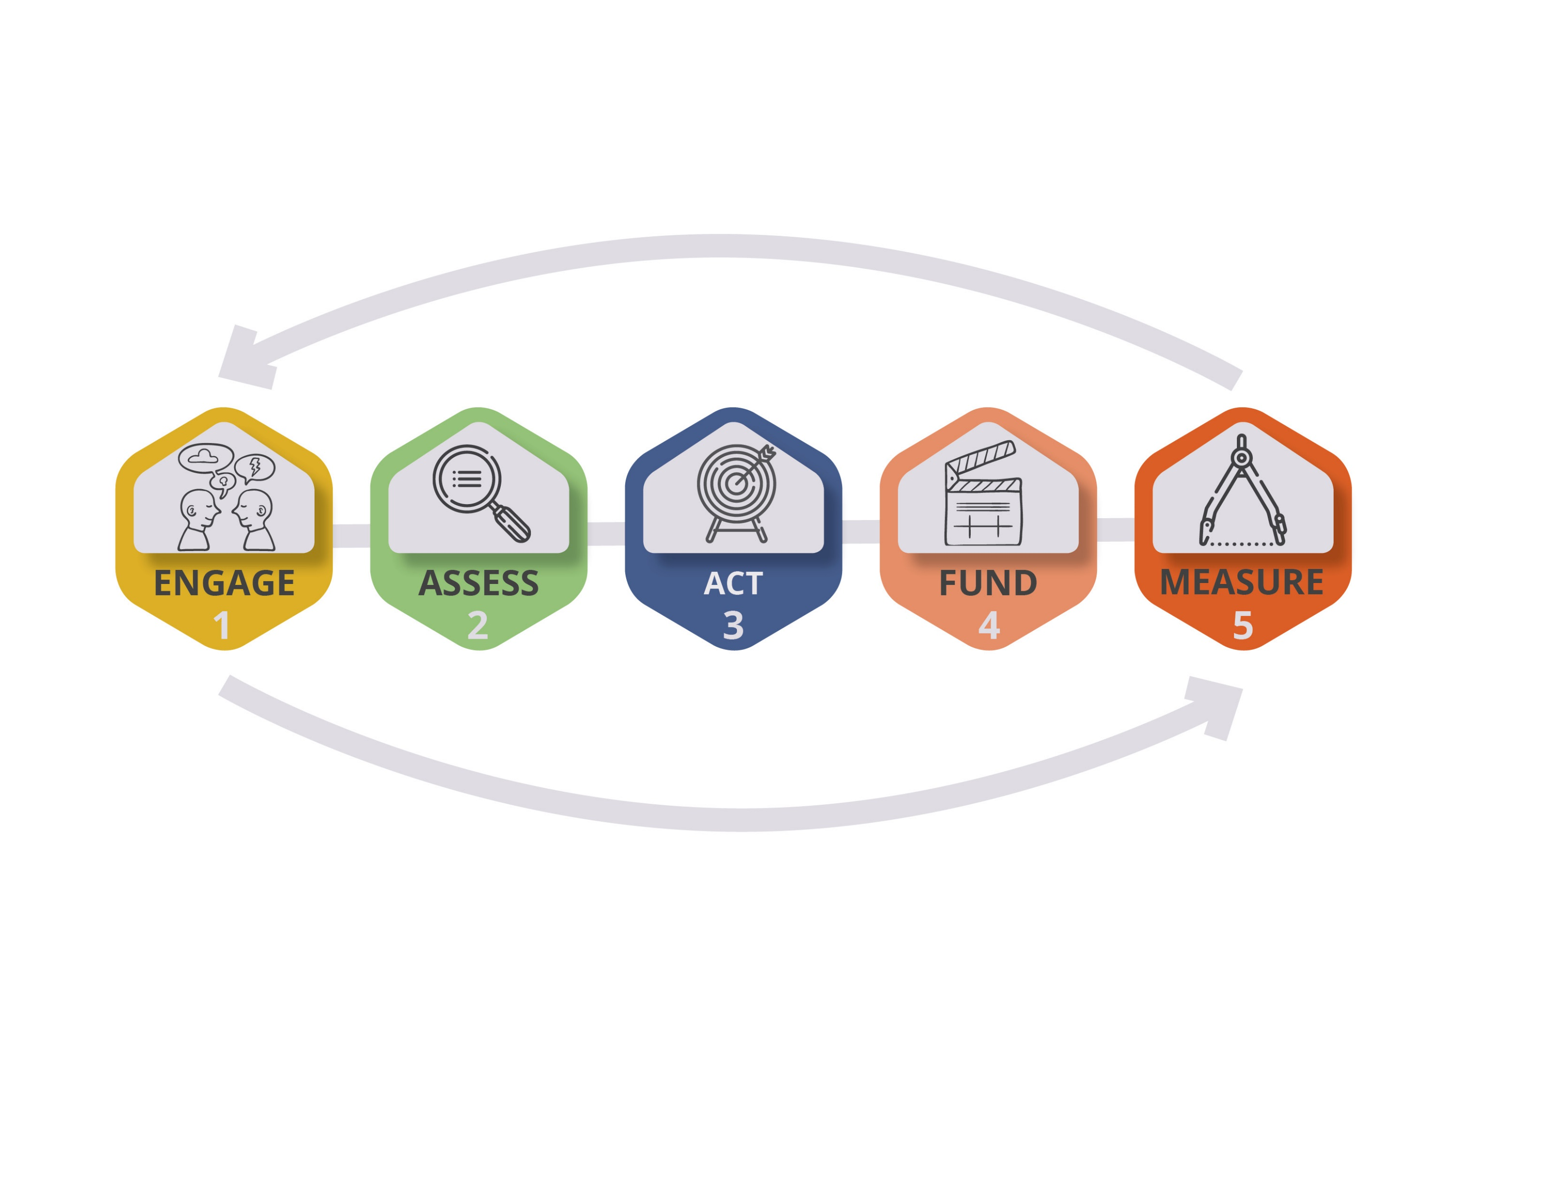
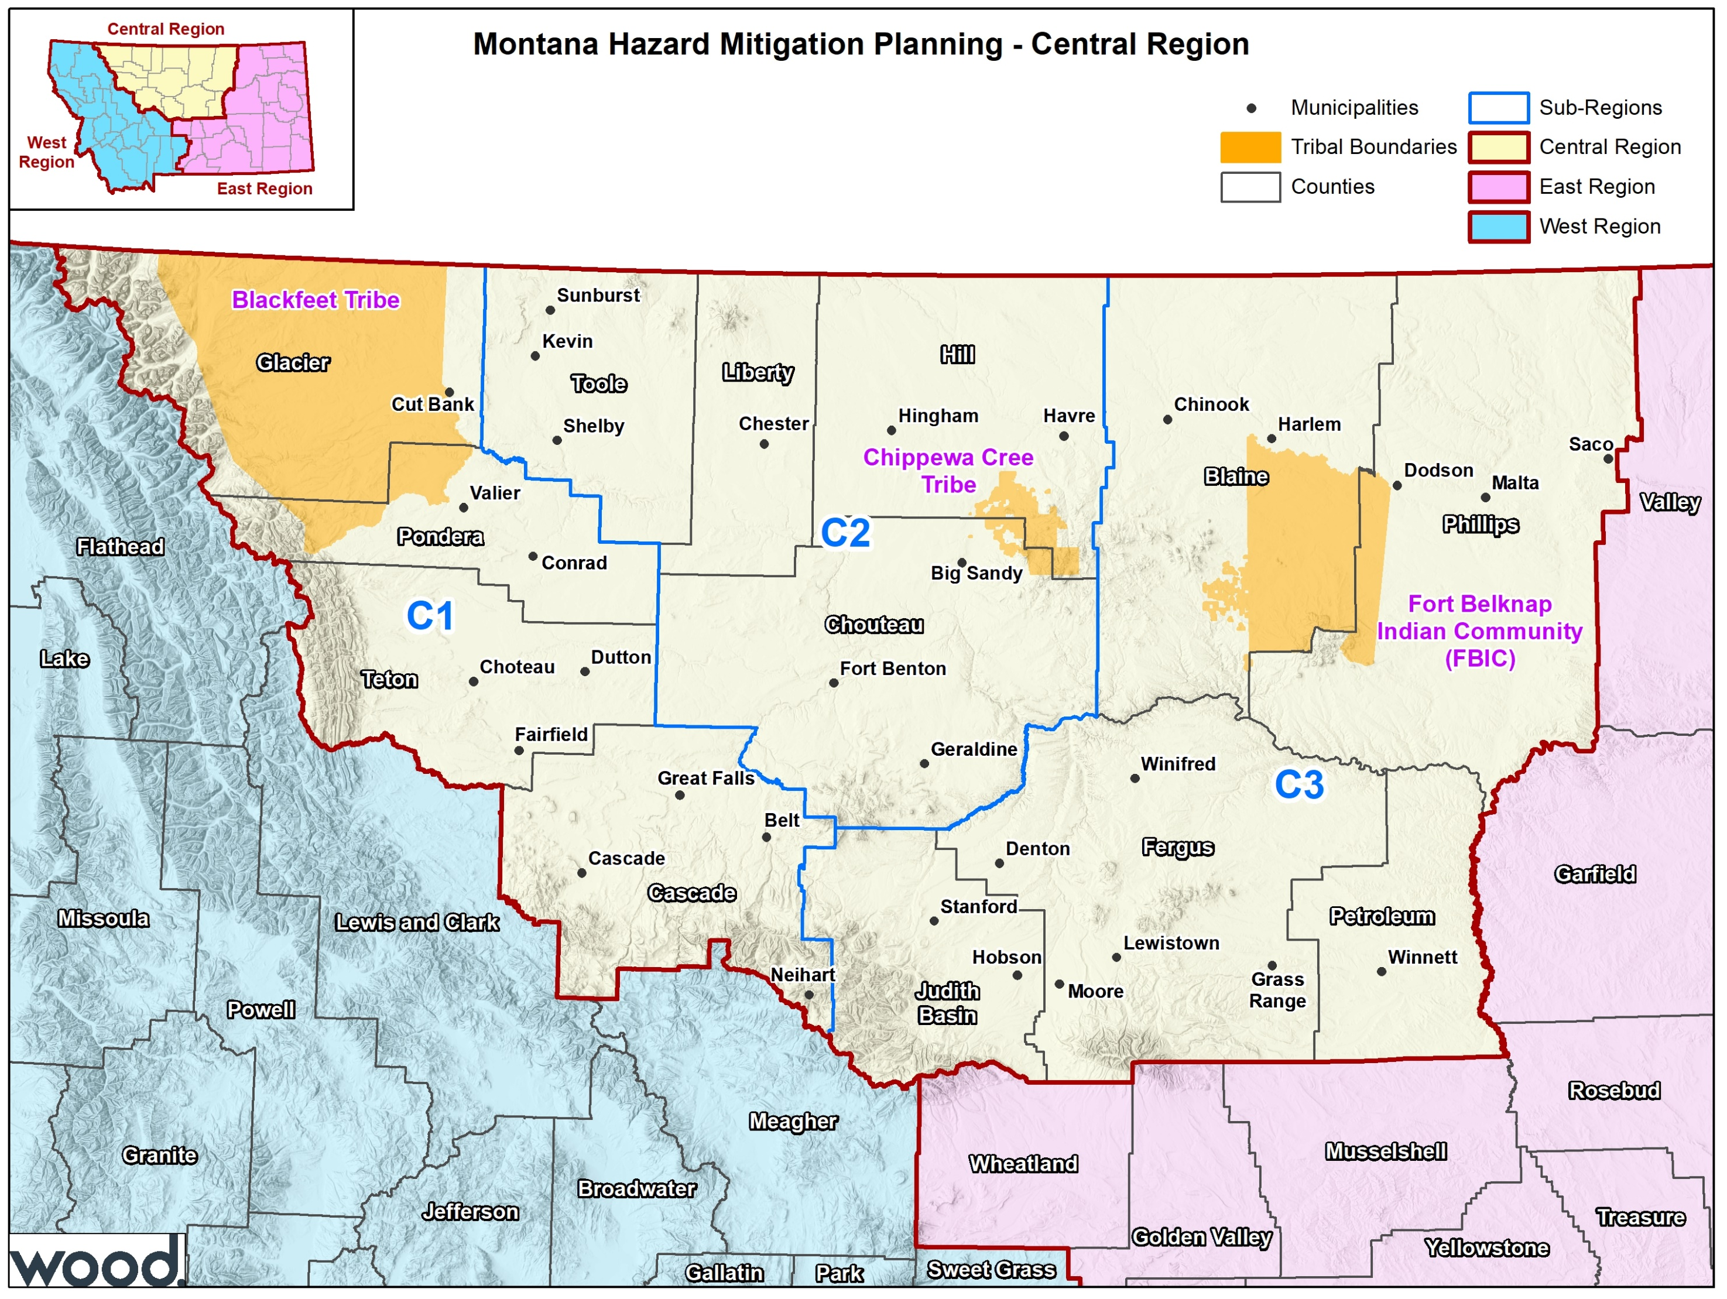
Phase 1: Organize Resources

Slide 21
Central Region - Subregions
Blackfeet Nation
Cascade County
Glacier County
Pondera County
Teton County
Blaine County
Fergus County
Fort Belknap
Judith Basin County
Petroleum County
Phillips County
Central Region
Chippewa Cree Tribe
Choteau County
Hill County
Liberty County
Toole County
C1
C2
C3

Slide 22
Regional Planning Framework
MT DES (Staff Support)
Wood (Consultant/Project Management)
Subregion 2:
Counties 1, 2, 3, etc.
Tribes 1, 2, etc.
County Staff
Municipal Staff
Stakeholders
Tribal Staff
Stakeholders
Subregion 3:
Counties 1, 2, 3, etc.
Tribes 1, 2, etc.
Regional Steering Committee and subregional groupings
County & Tribal Planning Teams
Regional Project Oversight and Management
Subregion 1:
Counties 1, 2, 3, etc.
Tribes 1, 2, etc.
County Staff
Municipal Staff
Stakeholders
Tribal Staff
Stakeholders
County Staff
Municipal Staff
Stakeholders
Tribal Staff
Stakeholders

Slide 23
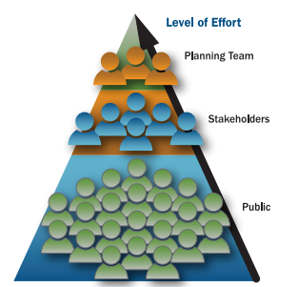
Create an Outreach Strategy: Plan for Public Involvement and Outreach
Required to provide 2 opportunities for public involvement
Initial: Before Plan Development
Final: Review Draft Plan
Continue public outreach
Documenting stakeholder engagement and public input
Options
Host public meetings or workshops
Include on planning team
Post draft plan on websites and hardcopies in libraries
Develop press releases
Use questionnaires/surveys

Slide 24
Review of Community Capabilities
What’s already in place related to hazard mitigation?
Conduct an inventory of communities’ existing and proposed policies, programs, and ordinances that may affect its vulnerability to hazards
Determine the communities’ technical & fiscal abilities to implement mitigation initiatives. Include ability to attract and leverage funding.
Consider any special opportunities to enhance or supplement these capabilities.
Planning and Regulatory
Administrative and Technical
Financial
Education and Outreach

Slide 25
Phase 2: Conduct a Risk Assessment
1. Identify and describe hazards
2. Identify assets
3. Assess risk
4. Summarize vulnerability

Slide 26
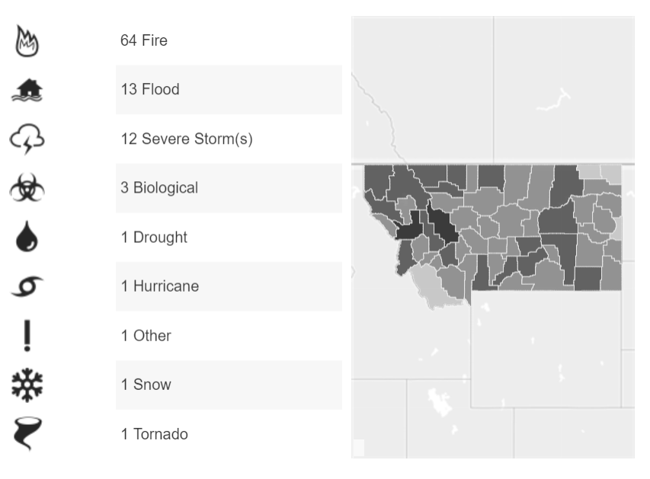
Hazard Identification
Has it Happened Before?
Information Sources:
Montana State Hazard Mitigation Plan (2018)
Existing County and Tribal Mitigation Plans
Community Wildfire Protection Plans
State/Local/Tribal THIRAs
Past disaster declarations
Planning team/community members
Existing plans and reports
GIS-based maps and data
Internet websites and databases
Newspaper/historical records
Local, state, and federal experts
97 Federal Disaster Declarations in Montana since 1953

Slide 27
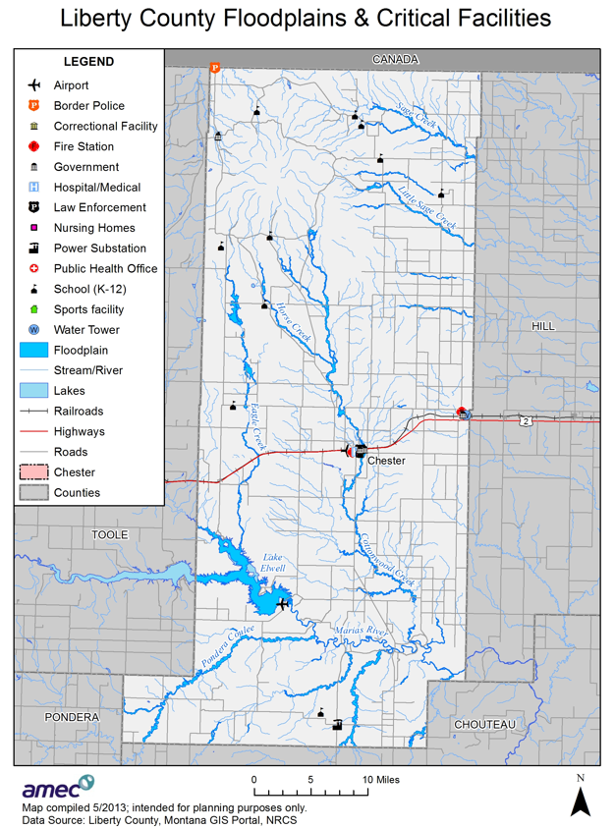
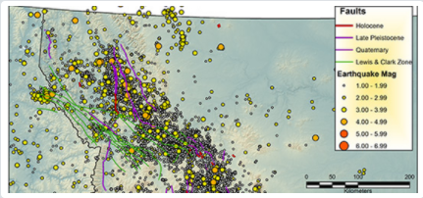
Profile the Hazards
Identify hazards affecting counties & tribes in the region
Profile the hazards that are likely to have impacts and are reasonable to mitigate
Hazard/problem description
Geographic Area Affected (maps where applicable)
Past occurrences
Frequency/likelihood of future occurrence
Magnitude (extent) /secondary effects
Climate Change Considerations

Slide 28
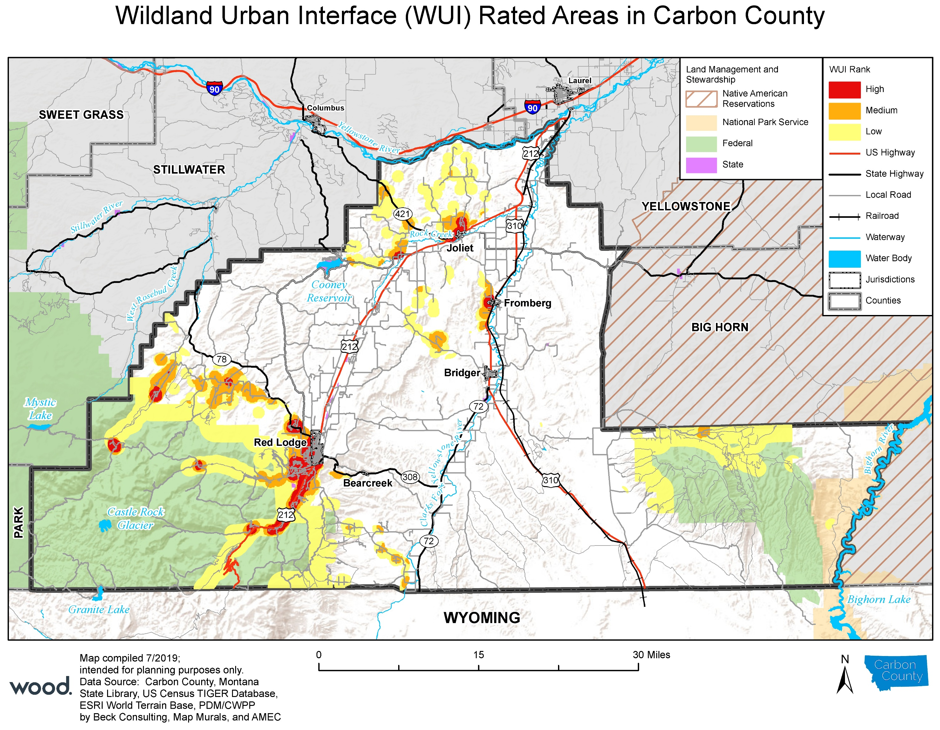

Vulnerability Assessment
Inventory Assets and Determine What Will be Affected
Inventory residential & commercial structures
Inventory critical facilities
Determine # and value of structures
Determine # of people in area
Identify vulnerable infrastructure
Identify development trends and constraints
Identify cultural, natural & historic resource areas
Estimate the losses

Slide 29
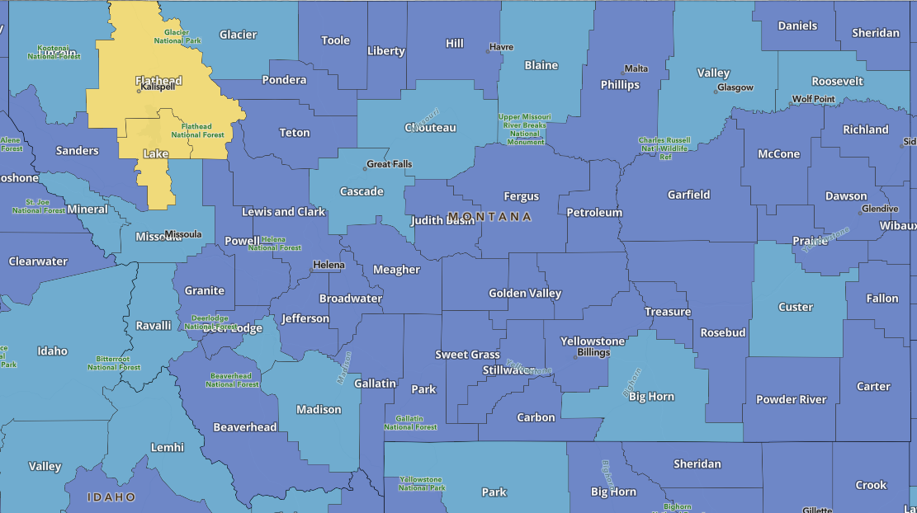
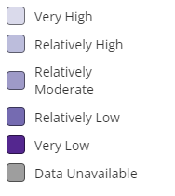
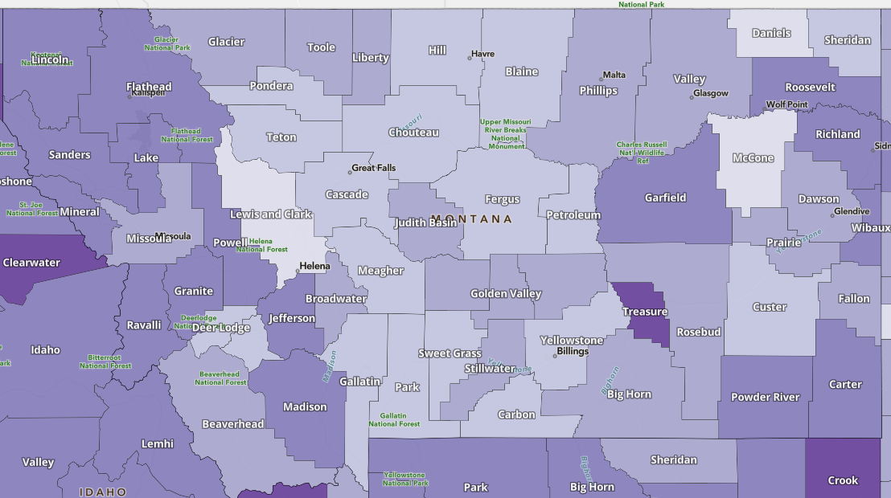
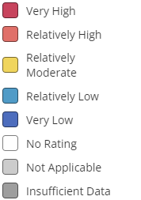
FEMA National Risk Index
https://www.fema.gov/flood-maps/products-tools/national-risk-index
Community Resilience
Risk Score

Slide 30
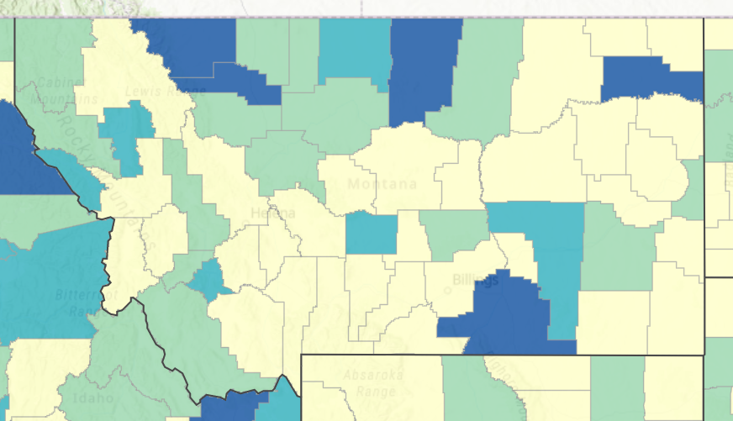
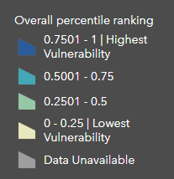
Social Vulnerability, Equity & Inclusion
CDC Social Vulnerability Index (SVI)
Socioeconomic status
Household composition & disability
Minority status & language
Housing type & transportation

Slide 31
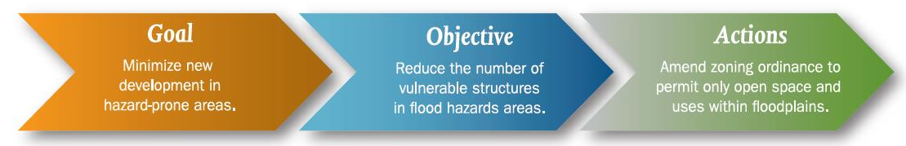
Phase 3: Develop a Mitigation Strategy
Review & update plan goals & objectives
Review mitigation alternatives
Draft an action plan

Slide 32
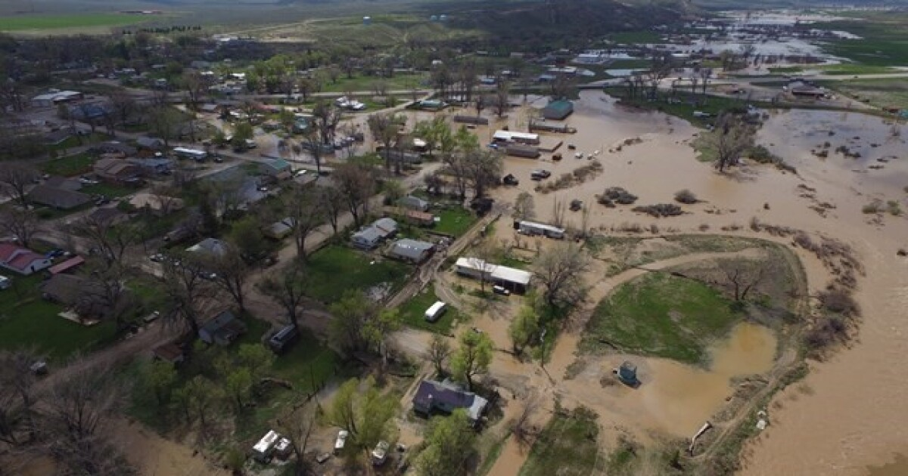
Develop Mitigation Goals
Should reflect the Risk Assessment
Areas of high vulnerability
Estimated losses
At-risk existing facilities
At-risk critical facilities
At-risk cultural and natural resources
Link with related goals from other existing plans
Reduce Losses to Existing and Future development
Considerations
Will we have one set of Regional Goals?
Or individual County/Tribal Goals?
Objectives (optional)

Slide 33
Mitigation Goals: 2018 Montana State HMP
Goal 1 – Reduce Impacts from All Hazards
Goal 2 – Reduce Impacts of Wildland and Rangeland Fires
Goal 3 – Mitigate the Potential Loss of Life and Property from Flooding
Goal 4 – Reduce Impacts from Earthquakes
Goal 5 – Reduce the Impacts from Drought
Goal 6 – Reduce Impacts from Severe Weather
Goal 7 – Reduce Losses from Hazardous Material Incidents and Transportation Accidents
Goal 8 – Minimize Impacts from Disease Outbreaks
Goal 9 – Reduce Impacts from Landslides and Avalanches
Goal 10 – Reduce Impacts from Dam Failure Hazard
Goal 11 – Reduce Impacts form Terrorism, Violence, Civil Unrest, and Cyber Security
Goal 12 – Reduce Impacts form Volcanic Ash

Slide 34
Update Status of Actions From Existing HMPs
Not Started: Work has not begun
In Progress: Work has begun but is not completed
Annual Implementation: Ongoing with no specific end date
Completed: The action has been finished
Deleted: The action is no longer relevant or cancelled due to changing priorities, lack of funds, etc.
There is no requirement or expectation to have completed any/all previous actions.

Slide 35
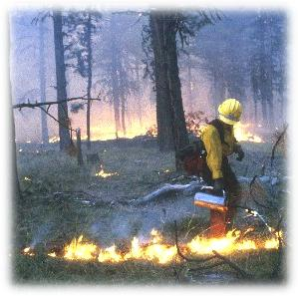
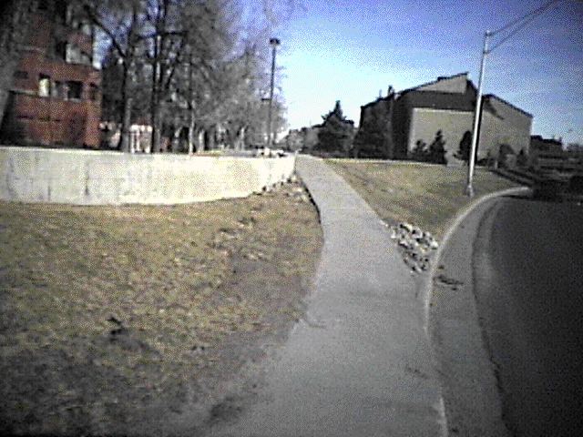
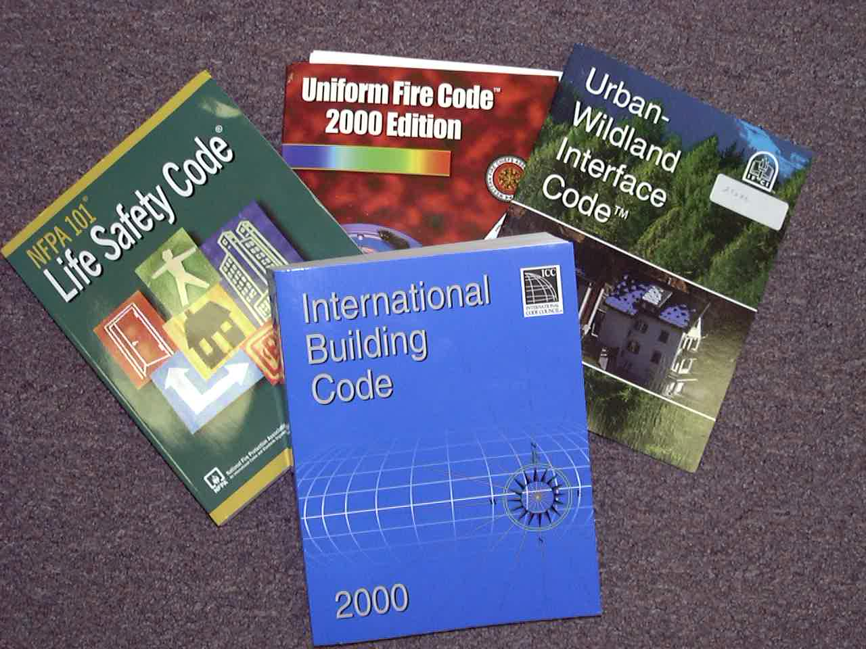
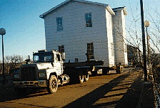
Categories of Mitigation Actions
Plans and Regulations
Structure and Infrastructure Projects
Education and Awareness
Natural Systems Protection
Actions must be prioritized

Slide 36
Review & Prioritize Mitigation Actions
STAPLEE Criteria
Social - Does the measure treat people fairly (different groups, different generations)? Does it consider social equity, disadvantaged communities, or vulnerable populations?
Technical - Will it work? (Does it solve the problem? Is it feasible?)
Administrative - Is there capacity to implement and manage project?
Political - Who are the stakeholders? Did they get to participate? Is there public support? Is political leadership willing to support it?
Legal - Does your organization have the authority to implement? Is it legal? Are there liability implications?
Economic - Is it cost-beneficial? Is there funding? Does it contribute to the local economy or economic development? Does it reduce direct property losses or indirect economic losses?
Environmental - Does it comply with environmental regulations or have adverse environmental impacts?

Slide 37
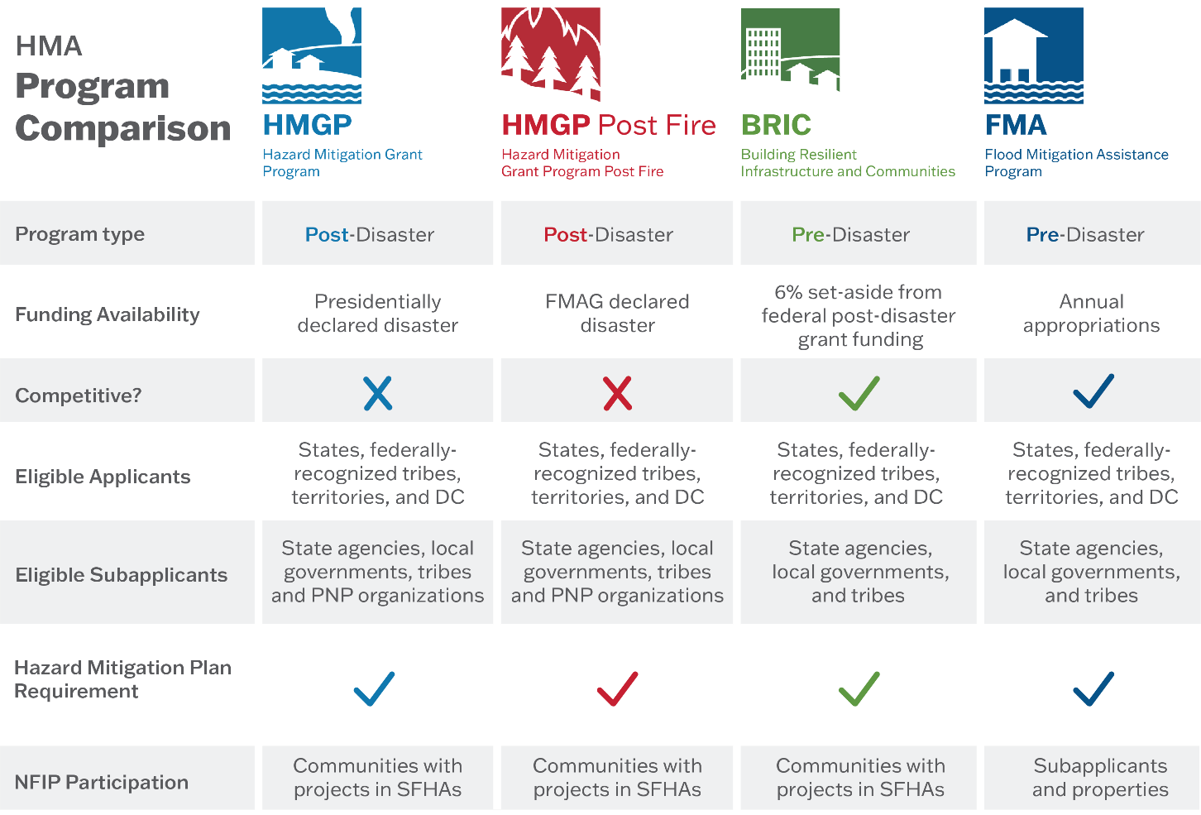
Funding Sources: FEMA Mitigation Grants
High Hazard Potential Dam (HHPD) Program
Pre-Disaster
Annual appropriation
Used to repair, rehabilitate or remove high hazard dams
Federally-owned dams are NOT eligible
Local match varies

Slide 38
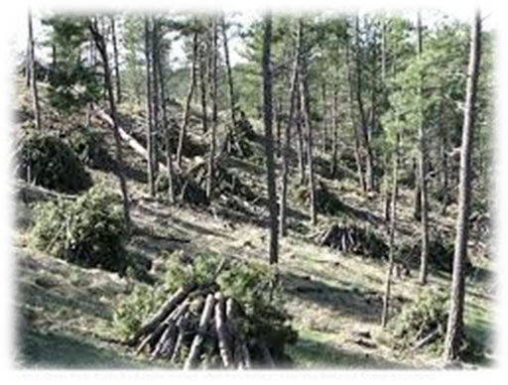
Wildfire Mitigation Projects Eligible for FEMA Funding
Defensible Space
Hazardous Fuels Reduction Activities
Community level vegetation management
Vegetation removal
Vegetation clearing and/or thinning
Slash removal
Vertical clearance of tree branches
Structural Protection Through Ignition-Resistant Construction Activities

Slide 39
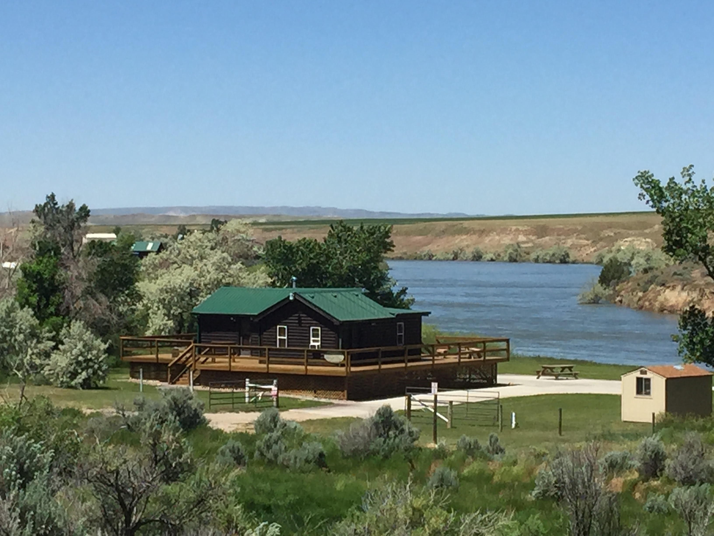
Flood Mitigation Projects Eligible For FEMA Funding
Acquisition
Dry and Wet Flood-proofing
Elevation
Minor Localized Flood Reduction Projects
Detention ponds
Channel stabilization
New Policy Change: Levee Projects if no duplication of programs with Army Corp
Infrastructure Retrofit
Culverts, bridges, etc.

Slide 40
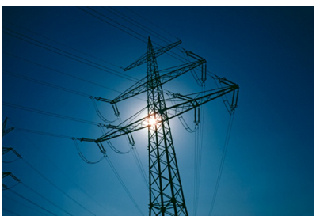
Other Mitigation Projects Eligible For FEMA Funding
Property Acquisition
Landslide Channel/Slope Stabilization
Utility Protection/ Infrastructure Retrofit
Rehabilitation of High Hazard Potential Dams
Safe Rooms
Generator Installation
Seismic Building/Infrastructure Retrofit
Climate Resilience Activities
Groundwater Recharge
Green Infrastructure

Slide 41
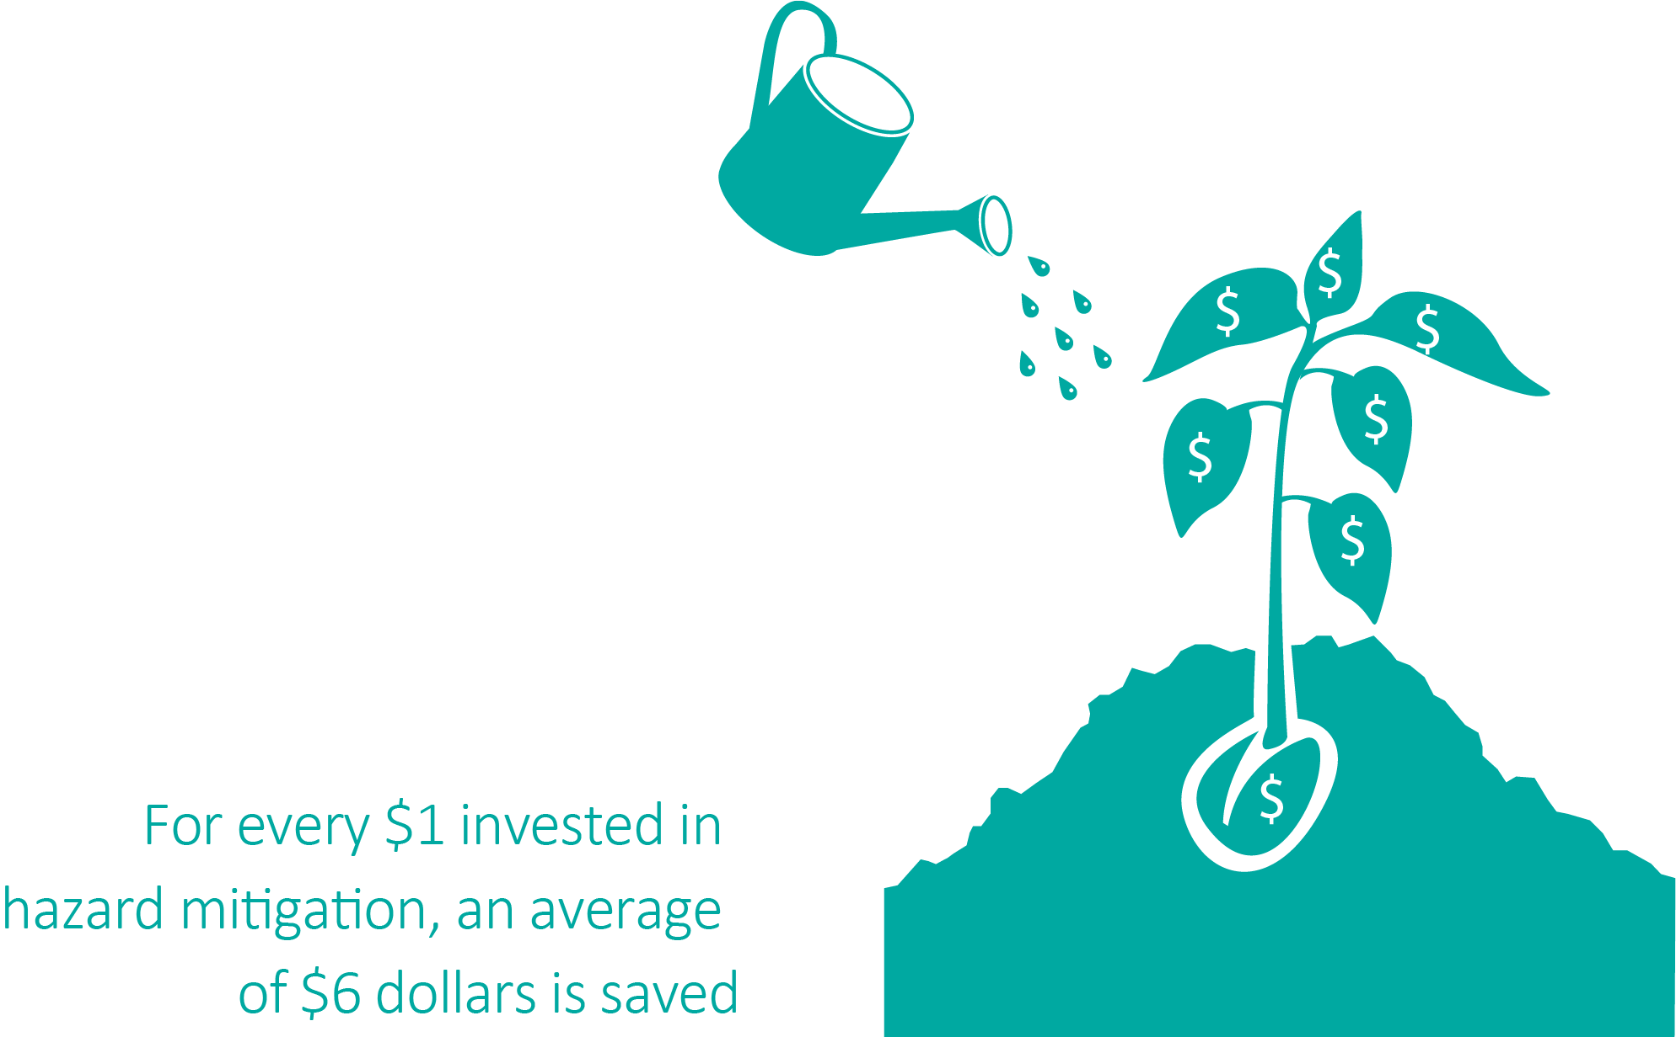
Phase 4: Plan Implementation & Maintenance
Keep the Plan Current
Plan maintenance procedures
Continue public involvement
Review and Adopt the Plan
Planning Team review
Public Review
State and FEMA Plan Review
Local government adoption
Create a Safe and Resilient Community
Implementing the plan to achieve mitigation goals
Securing funding and assistance

Slide 42
Draft The Regional Plan
Base Plan (Regional)
County Annexes
Tribal Annexes
Appendices
4 Drafts:
Internal CPT/TPT review
Public review
State review
FEMA review

Slide 43
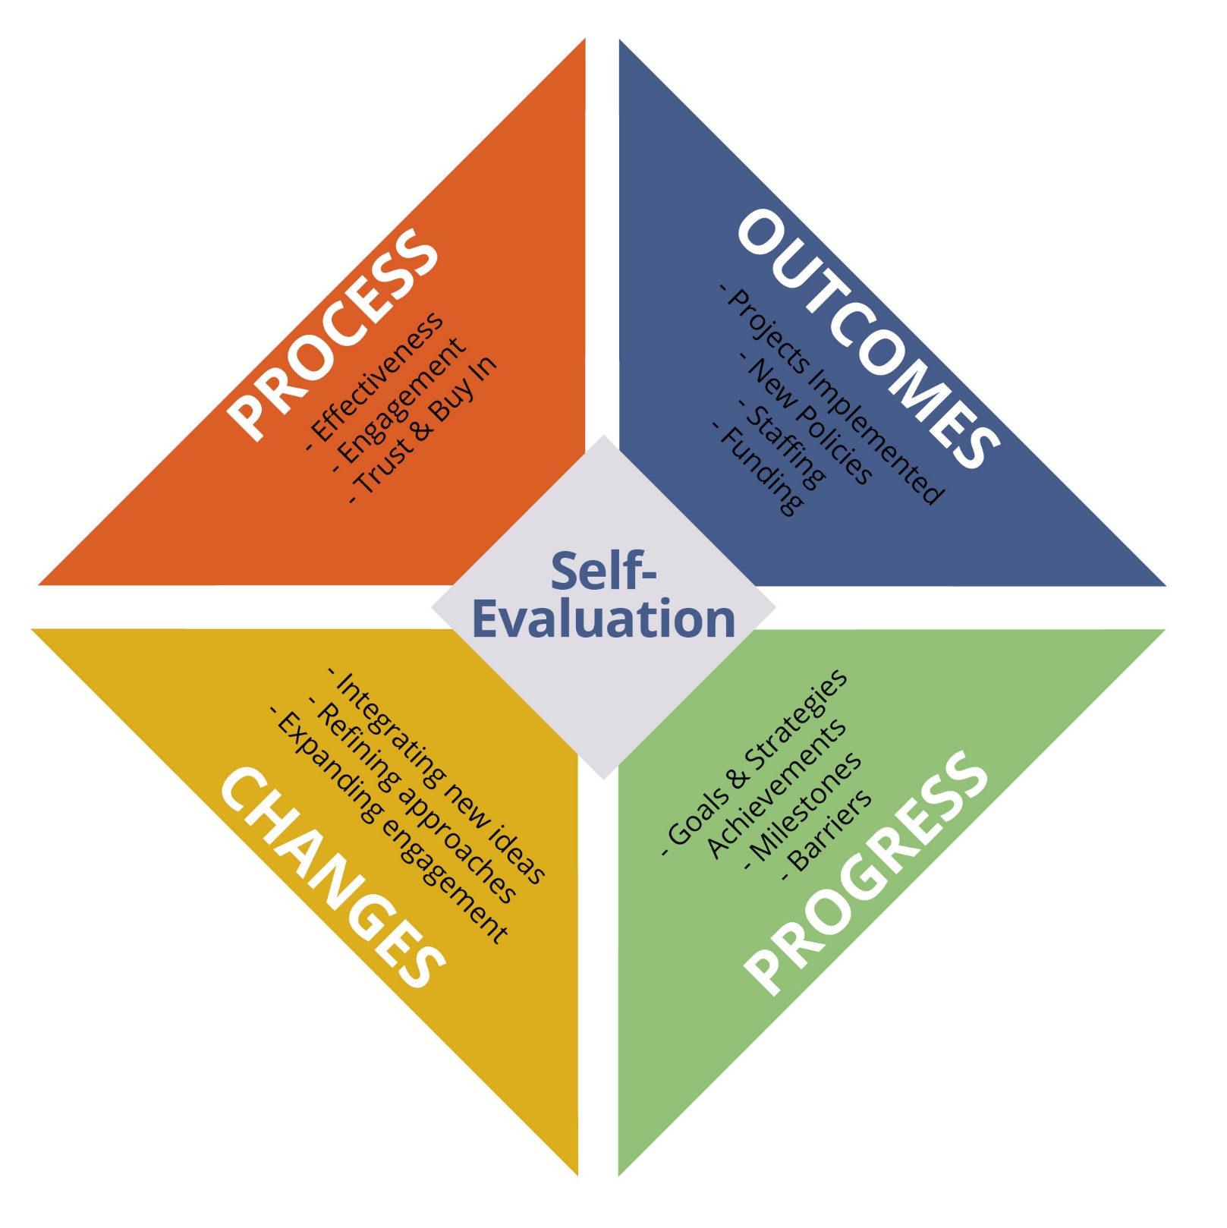
Monitoring, Evaluating, & Updating
What to Measure and Why
Outputs vs. Outcomes
Self-Evaluation
Measure and Refine

Slide 44
Regional, County, & Tribal Hazard Mitigation Planning Committees

Slide 45
Roles and Responsibilities
Steering Committee and County/Tribal Coordinators
Coordinate with respective CPTs/TPTs
Assist with meeting logistics
Primary point of contact with DES/Wood team
County and Tribal Planning Teams
Participate in the planning process
Assist with developing or updating the plan’s content
Tailor the plan to meet specific needs and issues
Participation is required for plan approval
MT DES
Oversee and coordinate the planning process
Regional support staff
Provide technical assistance
Contract management
Wood
Facilitate the planning process
Project management
Risk assessment and plan update/development

Slide 46
County & Tribal Planning Teams
Suggested local/tribal government representation
Public works
Transportation (road and bridge)
Planning and Community Development
Public Health
Fire departments/districts
Law enforcement
Floodplain administrators
Building department/code enforcement
GIS
Parks and recreation
Public information office
Administration
Starting points:
Previous HMP planning committee
Local Emergency Planning Committees
Multi-agency Coordination Groups

Slide 47
Including Stakeholders
MT DES
State Engineer/Dam Safety
Montana Dept. of Transportation Regional coordinators
Montana Bureau of Mines and Geology
Montana Dept. of Natural Resources & Conservation
Montana Fish, Wildlife & Parks
FEMA Region 8
EPA
US Forest Service
U.S.A.F.
NRCS
Bureau of Indian Affairs
Bureau of Land Management
Bureau of Reclamation
NOAA – NWS
Wildfire or watershed groups
Agricultural organizations
Local business and industry
Chambers of Commerce
Red Cross
Rural Electric Cooperatives
Power and Gas Providers
Rural Water Associations
Conservation Districts
School Districts
Special Districts
Neighboring Jurisdictions

Slide 48
Criteria for Identifying Stakeholders
Will be affected by the assessment or potential strategies
Represents typically underrepresented voices
Owns an asset that the community cares about
Has the authority to regulate, make policy, or make decisions about an asset
Has the potential to politically help or hinder the process of implementing strategies
Has specialized expertise that will help the county with technical questions
May be able to provide funding or otherwise assist in implementing strategies
May be able to make critical connections to other relevant topic areas and/or projects that the project team may not be aware of

Slide 49

What other stakeholders should be involved in this process?
ⓘ Start presenting to display the poll results on this slide.

Slide 50
Participation Specifics
Participating Jurisdictions (County, municipality, tribe, or special district)
Attend and participate in planning meetings/workshops
Provide available data requested of the County and Tribal coordinator and Wood
Provide input on local mitigation strategy (actions/projects)
Advertise and assist with public input process
Review and comment on draft plan
Coordinate formal adoption

Slide 51
Participation Specifics
Stakeholder: (state, federal government, other private, non-profit entity, other interested organizations)
Various options/level of participation
Attend CPT/TPT meetings or stay in loop via email list
Provide data/information
Partner on mitigation efforts
Review draft plan

Slide 52
Review of Identified Hazards

Slide 53
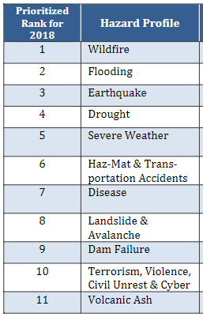
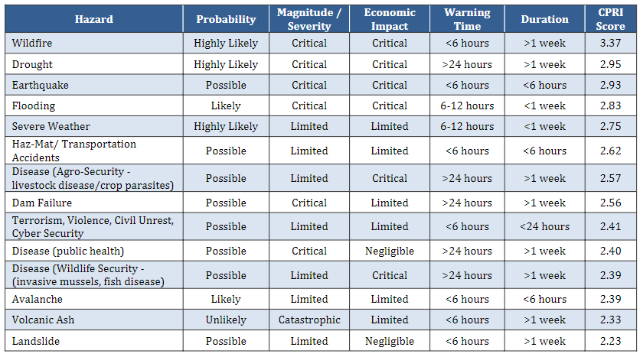
Statewide Hazard Identification
2018 State of Montana Hazard Mitigation Plan
Notes:
Table of on right represents ranking with CPRI. Plan notes planning team didn’t feel that accurately represented hazard priorities for state. Table on the left is how they prioritized rankings for state

Slide 54
Hazards In Local or Tribal Hazard Mitigation Plans
 | Flooding | Wildfire | Severe Winter Weather | Severe Summer Weather | Hazardous Materials Incidents | Drought | Dam Failure | Transportation Accident | Tornadoes, Severe Wind | Communicable Disease, Pandemic | Terrorism, Violence, and Civil Unrest | Cybersecurity | Earthquake | Landslide | Structure Fire | Agrosecurity | Volcanic Ashfall | Water Supply Pipeline | Border Security & Protection | Human Trafficking | Methamphetamine Abuse/Addiction | Mass Casualty
Blackfeet Nation Plan 2007 | X | X | X | X | X | X | X | X | X | X | X | X | X |  |  | X |  | X
Cascade County Plan 2017 | X | X | X | X | X | X | X | X |  | X | X | X
Glacier County Plan 2018 | X | X | X | X |  | X |  |  | X
Pondera County Plan 2018 | X | X | X | X |  |  | X |  | X
Teton County Plan 2021 | X | X | X | X | X | X |  |  | X |  |  |  | X | X
Chippewa Cree Plan 2020 | X | X | X | X | X |  | X | X |  | X | X | X |  | X
Choteau County Plan 2017 | X | X | X | X | X |  |  |  |  | X |  |  |  |  | X | X |  |  |  |  |  | X
Liberty County Plan 2013 | X | X | X | X | X | X
Hill County Plan 2018 | X | X | X | X | X |  | X | X |  | X | X | X |  | X | X
Toole County Plan 2013 | X | X | X | X | X |  |  |  | X |  |  |  | X | X |  |  | X
Blaine County Plan 2012 | X | X | X | X | X |  | X | X |  |  |  |  |  |  | X
Fergus County Plan 2014 | X | X | X | X | X | X | X |  |  | X | X |  |  | X
Fort Belknap Plan 2022 | X | X | X | X | X | X | X |  |  | X |  | X | X | X |  |  | X |  | X | X | X
Judith Basin County Plan 2013 | X | X | X | X | X | X |  | X |  |  |  |  |  |  |  | X
Petroleum County Plan 2008 | X | X | X |  | X | X |  |  | X | X | X |  | X |  | X |  | X
Phillips County Plan 2006 | X | X | X | X | X | X | X | X | X |  | X | X | X |  |  |  |  | X
Total | 16 | 16 | 16 | 15 | 14 | 10 | 9 | 7 | 7 | 8 | 7 | 6 | 6 | 6 | 4 | 3 | 3 | 2 | 1 | 1 | 1 | 1

Slide 55
What additional hazards should be considered for the Regional Plan?
ⓘ Start presenting to display the poll results on this slide.

Slide 56
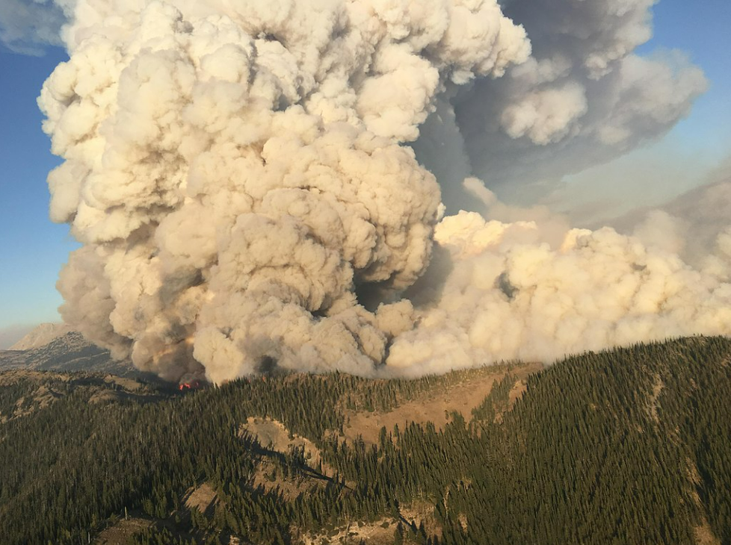
Hazard Events in Central Montana Since 2017
Montana Covid-19 Pandemic (DR-4508-MT)
Montana Flooding (DR-4388-MT)
Montana Strawberry Fire (FM-5212-MT)
Montana Lodgepole Fire Complex (FM-5194-MT)
Denton grassland and urban fire December 1, 2021
Strawberry Fire 2017

Slide 57
What other significant hazard events have occurred in the past 5 years? Note which jurisdiction(s) was impacted.
ⓘ Start presenting to display the poll results on this slide.

Slide 58
Hazard Information Sources
Local Hazard Mitigation Plans
2018 State of Montana Regional State Hazard Mitigation Plan
Montana Resilience Framework for Communities
2017 Montana Climate Assessment (MCA)
State and Local THIRAs, Public Health Risk Assessments
National Risk Index
CWPPs and wildfire risk studies
Historic incidents/incident reports
Scientific studies
Other plans and reports (Flood and drainage studies, strategic plans, internet databases)
Recent disasters
Public perception

Slide 59
County, Tribal and Municipal Assets Exposed
Use of best available data
Building inventory
Statewide parcel and Assessor’s database
Critical Facilities/Assets
Local GIS databases
Other state/federal sources
Existing HMPs: Review for changes/updates

Slide 60
What growth and development trends in past 5 years has your community experienced that may increase or decrease vulnerability to hazards? (i.e. more homes in wildland urban interface, floodplain development pressure etc.)
ⓘ Start presenting to display the poll results on this slide.

Slide 61
Coordination with Related Planning Efforts & Recent Studies

Slide 62
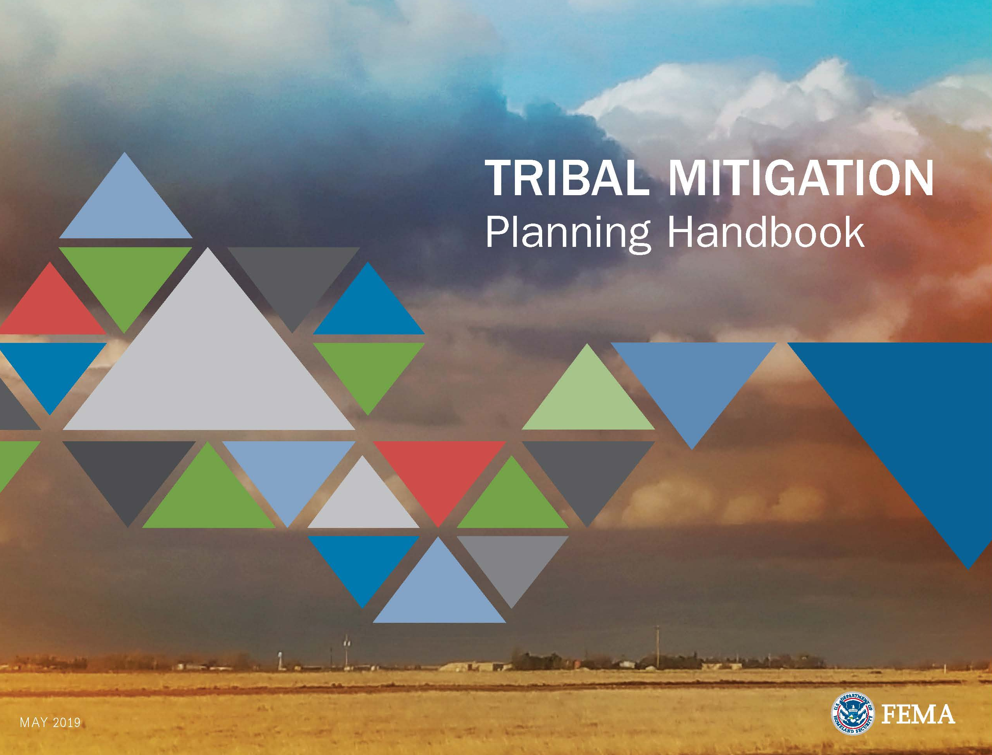
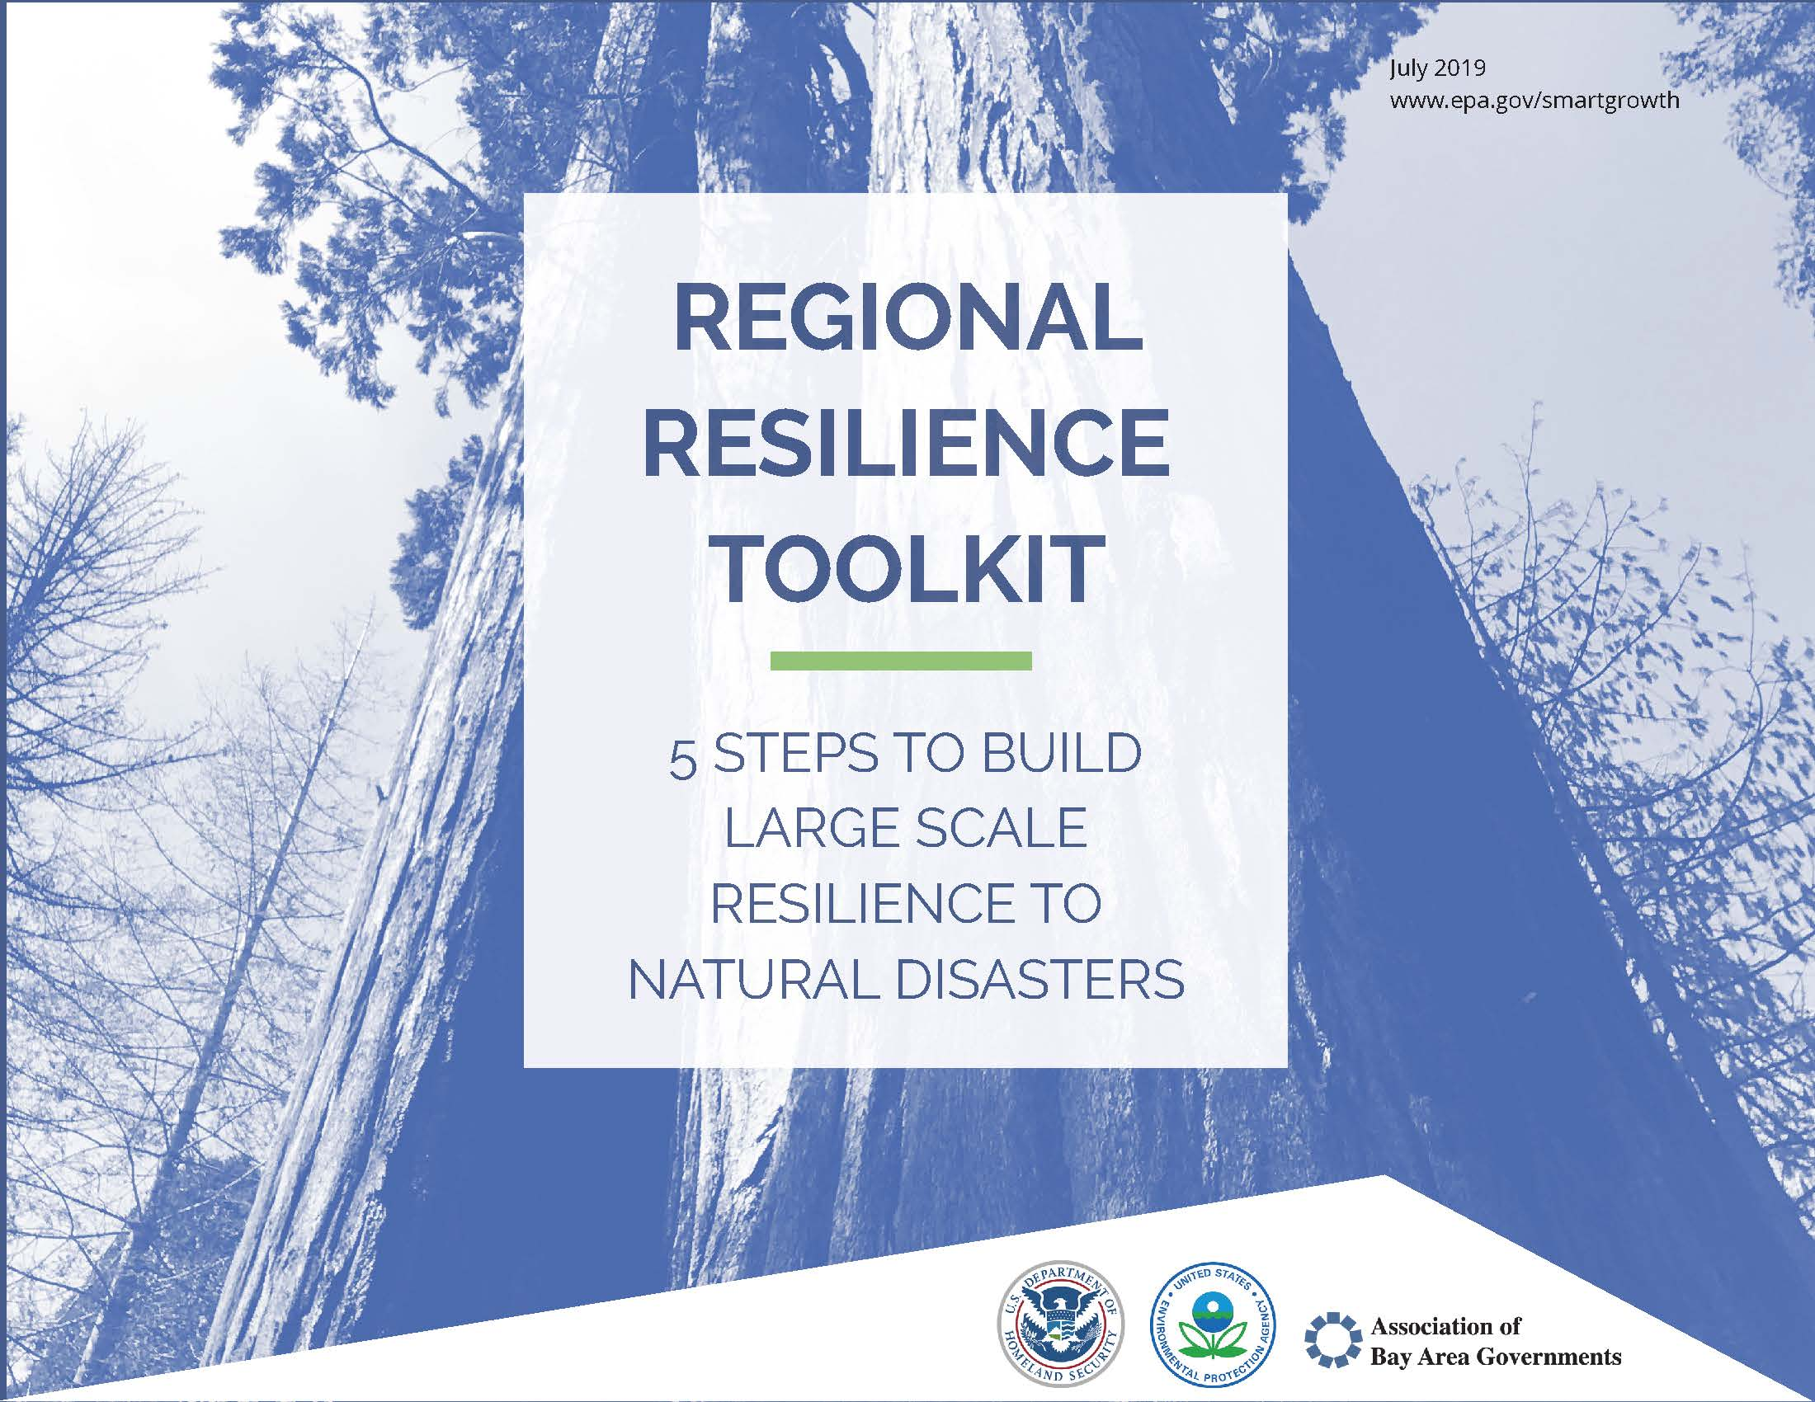
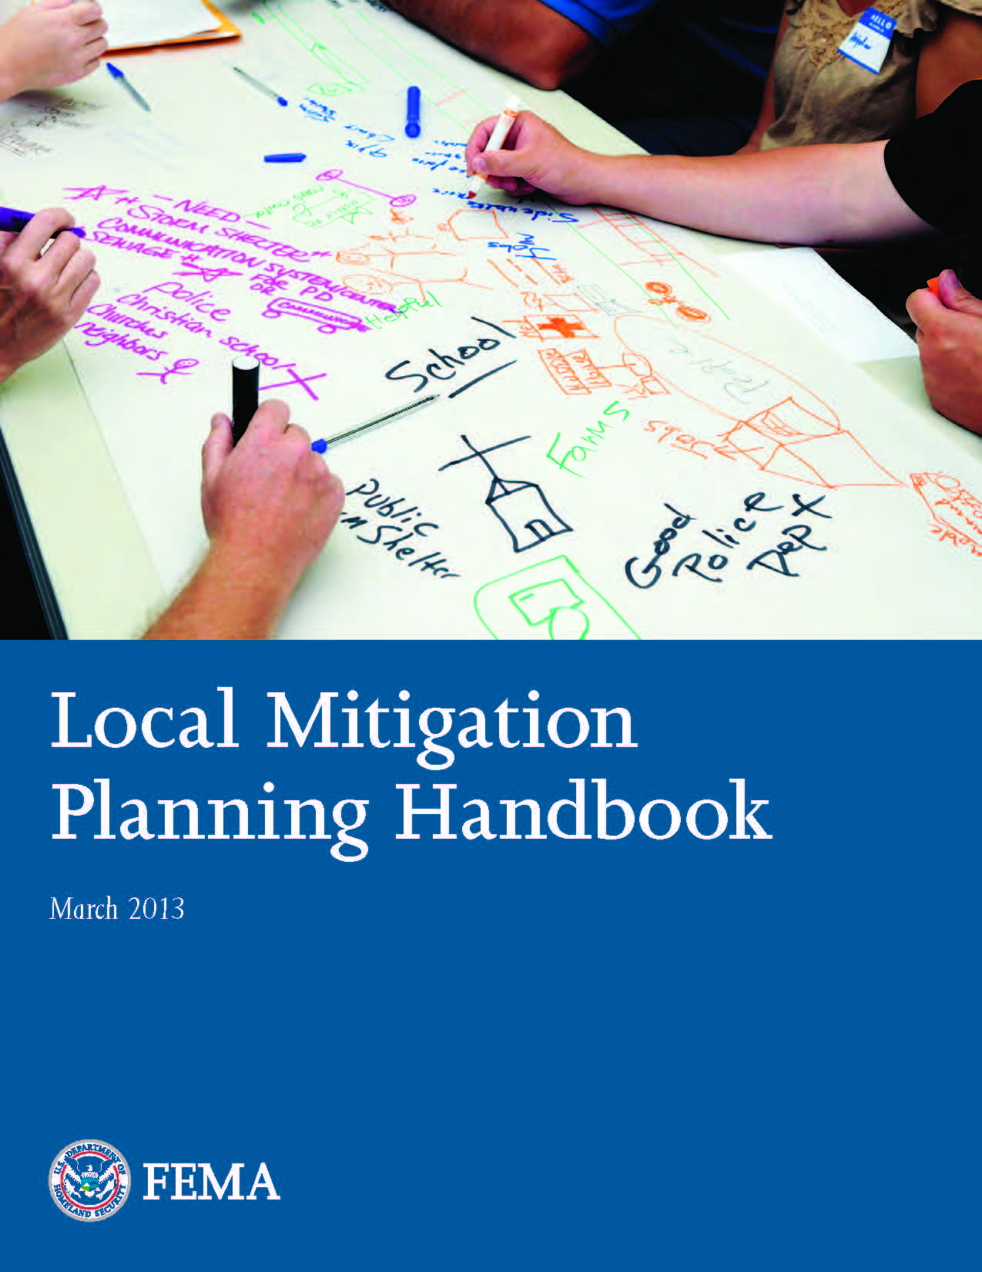
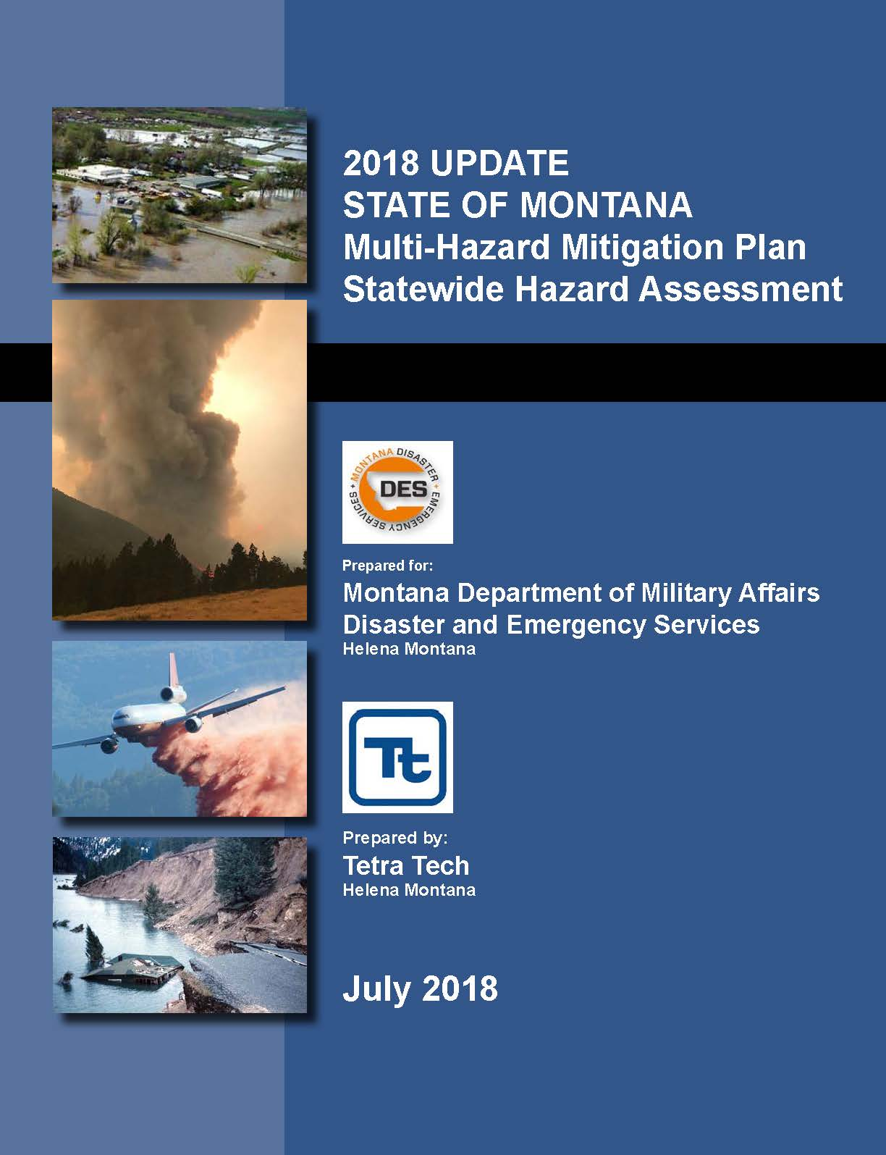
Data Collection: Lay the Groundwork
Regulatory Requirements
Resilience Lenses: Hazard risk reduction and social equity focus on vulnerable populations
Plan Guidance
Identify and Map Hazards
What hazards pose the greatest threat to the Central Region communities?
What are the past hazard patterns?
Develop Hazard Problem Statements
Climate Stressor Thresholds:
Identification of potential thresholds for critical climate stressors?
How will climate change intensify or increase the hazards in the future?
FEMA Tribal Mitigation Planning Handbook
EPA Regional Resilience Toolkit
Montana Central Region Hazard Mitigation Plan
FEMA Local Mitigation Planning Handbook
State Hazard Mitigation Plan

Slide 63
Plans Related to the MT Central Region HMP: Plan Integration
Montana
State
Water
Plan
Montana
Resilience
Framework for
Communities
Montana
Drought
Plan
Montana Disaster and Emergency Services
Regional Hazard Mitigation Plan
Montana State
Hazard
Mitigation Plan
Non-Point
Source
Management
Plan
Climate
Solutions
Plan
Montana
Forest
Action
Plan

Slide 64
Coordination and Integration With Other Plans
What related plans should this plan be linked to?
Community Wildfire Protection Plans
Comprehensive/Land Use Plans
Capital Improvement Plans
Water Risk and Resilience planning per America’s Water Infrastructure Act
Montana Forest Action Plan
Montana State Water Plan
Non-Point Source Management Plan
Climate Solutions Plan
What related planning efforts are underway? E.g. tribal drought planning

Slide 65
What other existing or recent plans, reports, or studies should be reviewed for this planning process?
ⓘ Start presenting to display the poll results on this slide.

Slide 66
What opportunities exist to coordinate or integrate the Hazard Mitigation Plan with other planning mechanisms?
ⓘ Start presenting to display the poll results on this slide.

Slide 67
Planning for Public and Stakeholder Involvement

Slide 68
Planning for Public and Stakeholder Involvement
Proposed activities – Wood assistance
Online survey will be developed
Virtual public meeting engagement room
Virtual public meeting
Draft plan for public review with online feedback form
Counties and Jurisdictions
Discussion of the Regional Plan as an agenda item at County Commissioner meetings and tribal and town council meetings.
Assisting posting the draft plan online and soliciting comments prior to submittal to MT DES/FEMA.
Hosting additional meetings as desired

Slide 69
Project Website
Project website will be developed to include:
Presentations, agendas, minutes from planning team and public meetings
Draft plan sections and documents planning team and public review
Resources to support the plan development, such as the Regional Resilience Toolkit, FEMA Mitigation Ideas publication
Project schedule
Upcoming meeting dates
Descriptions of identified hazards for public education
Access to a public survey for public and stakeholder input

Slide 70
Are there any upcoming opportunities for outreach at scheduled public meetings or events?
ⓘ Start presenting to display the poll results on this slide.

Slide 71
Information Needs and Next Steps

Slide 72
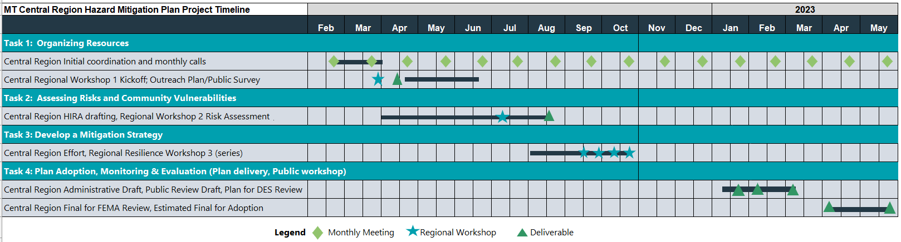
Project Tasks and Schedule
2022

Slide 73
Initial Information Needs/Next Steps
Data Collection Guide will be developed
Complete one for each county, municipality, and tribe based on various department input
Capture details on:
Recent hazard impacts in last 5 years
Capability assessment updates
GIS data collection
Stakeholders
Provide additional information as applicable – hazards, plans, projects
Stay in loop via email group from DES, County and Tribal Coordinators
Future planning workshops in spring/summer dates TBD

Slide 74
Questions?
Central Region Project Manager/
Mitigation Coordinator
Hannah Shultz
Montana DES
Hannah.Shultz@mt.gov
406-292-1092
Project Manager
Jeff Brislawn
Wood Environment & Infrastructure Solutions, Inc
Jeff.brislawn@woodplc.com
303-704-5506
Lead Planner
Scott Field
Wood Environment & Infrastructure Solutions, Inc
Scott.field@woodplc.com
720-569-9266

Slide 76
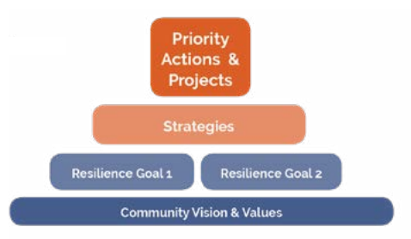

Slide 77
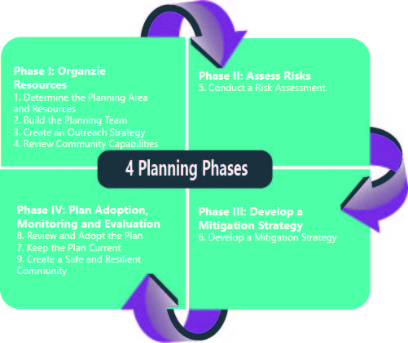
FEMA’s Original Four Phase Planning Guidance

Slide 78
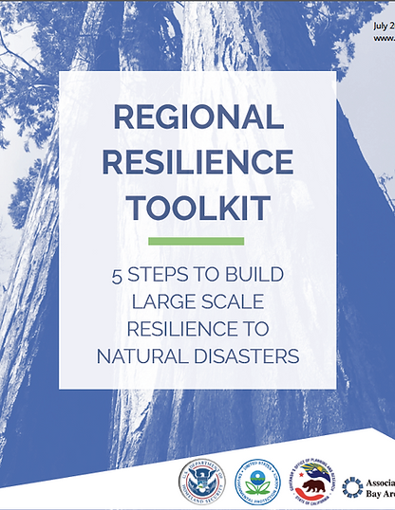

EPA Regional Resilience Toolkit Steps
Step 1 Engage: Engagement for Resilience
Step 2 Assess: Conduct Vulnerability Assessment
Step 3 Act: Identify and Prioritize Strategies
Step 4 Fund: Fund for Action
Step 5 Measure: Evaluate Results and Refine Methods

Slide 79
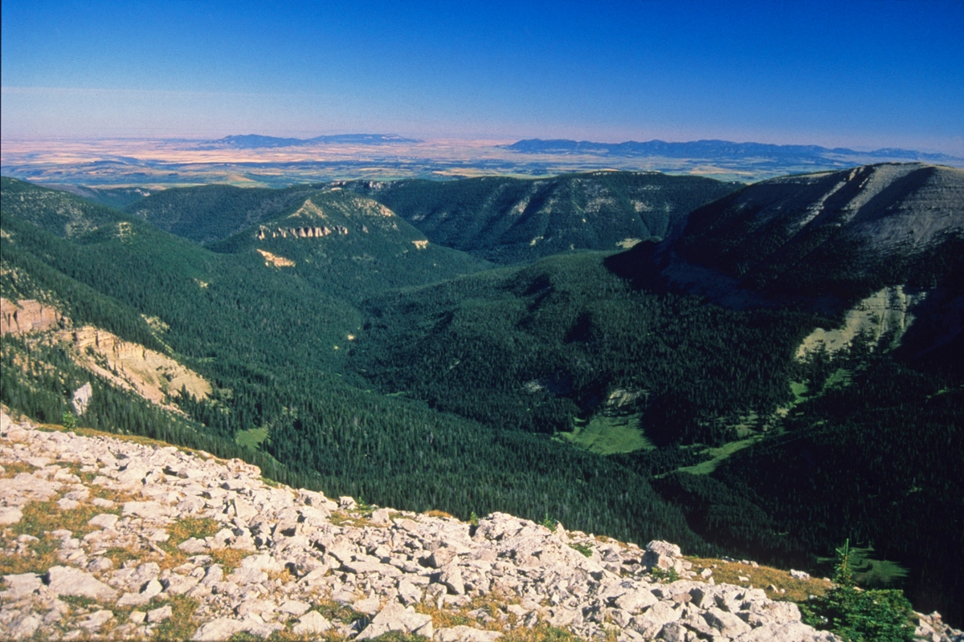
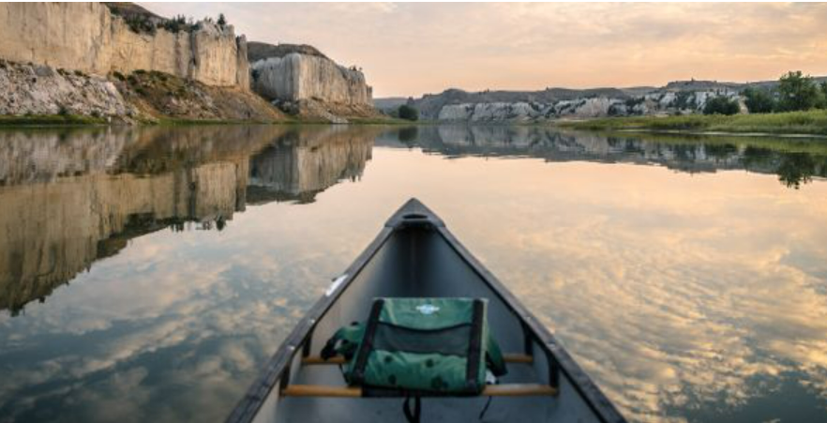
Hazard Identification
Has it Happened Before?
Information Sources:
Montana State Hazard Mitigation Plan (2018)
Existing County and Tribal Mitigation Plans
Community Wildfire Protection Plans
State and Local THIRA
Past disaster declarations
Planning team/community members
Existing plans and reports
GIS-based maps and data
Internet websites and databases
Newspaper/historical records
Local, state, and federal experts
Looking north from the crest of the Big Snowy Mountains offers stunning views of Lewistown and the Judith and North and South Mockisin mountains. (Photo by Rick and Susie Graetz)

